Slide 1
Fighting (and other forms of aggression)
Week 9
Foundations of Animal Behavior
Emily Levy

Slide 2
Note: I didn’t quite finish this lecture, but wanted to include what I did get to so you can have a look! The main components missing are looking at the ecological and evolutionary drivers of aggression. Also missing lots of fun photos ☹

Slide 3
Learning outcomes
Understand reasons for fighting
Understand costs and benefits of fighting
Understand mechanisms of aggression

Slide 4
Outline
Why be aggressive?
A brief rabbit-hole: Dominance hierarchies
Proximate drivers of aggression

Slide 5
Why be aggressive?

Slide 6
Why be aggressive?
Mates
Food
Territory (space)
Safety for selves, family, or group

Slide 7
When should you be aggressive?
Must think economically
Compare cost to benefit
Some considerations:
How much would winning increase my fitness? (benefit)
How much would losing decrease my fitness? (cost)
Who am I competing against?
Is the resource more valuable to me than to my competitor? (remember bats!)
If I don’t win now, will I ever have another chance? (life span)
If I win now, will I just immediately lose to someone else? (stability)
Cost
Benefit
Size of competitor
Quality of food
Quality of territory

Slide 8
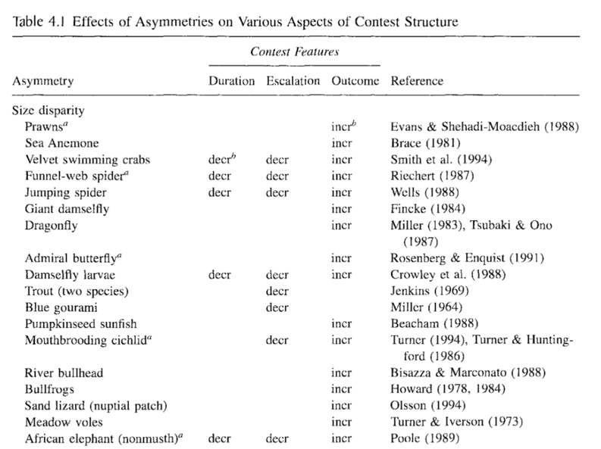
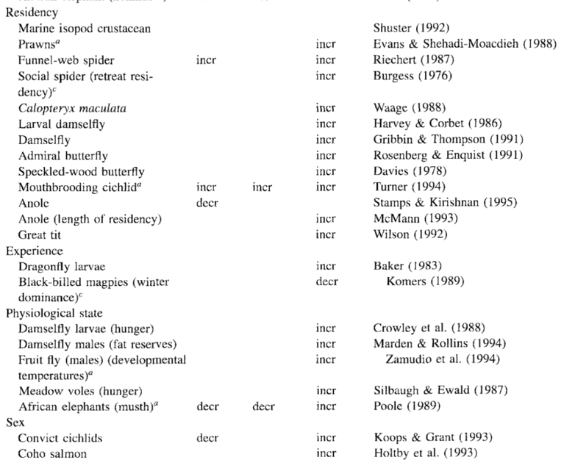
Contests in context
Asymmetries = Differences between two contestants across a range of aspects:
Size, how nice your home is, etc
More asymmetry typically decreases duration or escalation
Can reliably predict outcome
Reichert 1998

Slide 9
Contests in context
“…if asymmetries regularly exist in a given system and animals are able to accurately measure these, then contests may be short and limited to displays.”
Differences between two contestants across a range of aspects:
Size, duration of food deprivation, how limited the mating opportunities are, how limited food availability is
More asymmetry typically decreases duration or escalation
Can reliably predict outcome
Reichert 1998

Slide 10
Contests in context
“…if asymmetries regularly exist in a given system and animals are able to accurately measure these, then contests may be short and limited to displays.”
Differences between two contestants across a range of aspects:
Size, duration of food deprivation, how limited the mating opportunities are, how limited food availability is
More asymmetry typically decreases duration or escalation
Can reliably predict outcome
https://www.youtube.com/watch?v=-cKrIsqd6TA
Reichert 1998
Notes:
Galapagos tortoises: males ‘fight’ mainly by seeing who can raise their heads higher

Slide 11
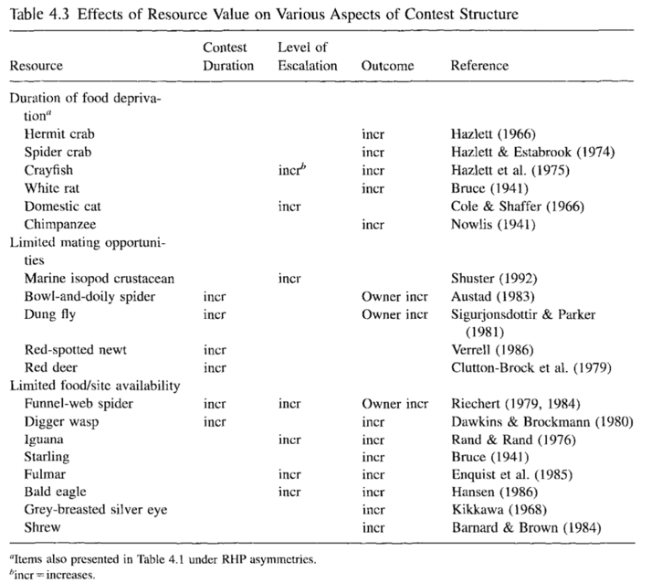
Contests in context
Differences in resource value affect aggressive behavior
Resources can have different values to different competitors
The higher the value (benefit), the higher the duration and escalation
Reichert 1998

Slide 12
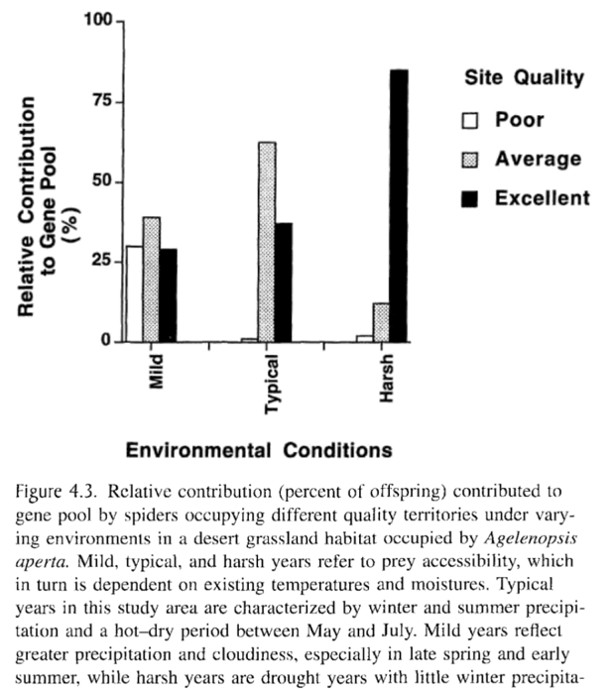
Contests in context
Desert grass spider, Agelenopsis aperta
Differences in resource value affect aggressive behavior
Resources can have different values to different competitors
The higher the value (benefit), the higher the duration and escalation
Reichert 1998
Notes:
The higher the stakes, the more competitive the environment

Slide 13
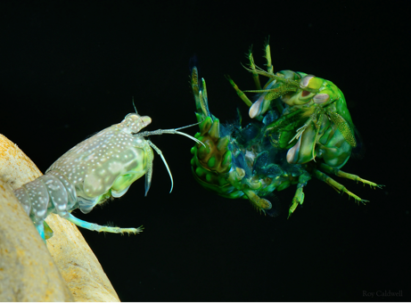
A few types of fights
Solitary species: with other randos
Group-living species:
Within-group
Between-groups
Notes:
Shrimp: Roy Caldwell
Baboons: David Clode
Chimps: Sylvia Amsler

Slide 14
Mechanisms of aggression
Fight or flight (stress response)
Surges in adrenaline, cortisol can help you fight
Hormonal mediators
Higher T in mammals often associated with higher chance of winning;
Winning can also boost T (and vice versa)
Injecting lobsters with serotonin increases aggressiveness
Hormonal effects not always consistent across species! Atlantic char, more subordinate individuals have higher serotonin
Pre-empting a fight
Communicate status to avoid fighting
Baboons: Tail up
Dogs: Roll on belly
Atlantic salmon: Darker color
Notes:
Salmon study: Keenleyside & Yamamoto 1962

Slide 15
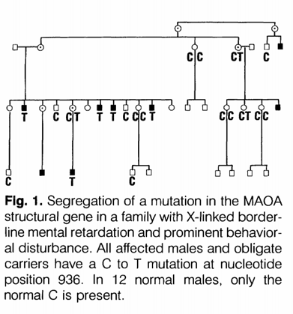
Mechanisms of aggression – in humans
Aggression runs in families; 10% of families responsible for 50% of crime
Twin studies confirm heritability of aggression (~45%)
Severe aggression (paired with ID) in many men in a large Dutch family led to…
Single gene, MAOA, encodes monoamine oxidase A (MAO-A), an enzyme in mitochondria that helps break down molecules
C → T point mutation
Brunner et al 1993
Buckholtz & Meyer-Lindenberg 2008

Slide 16
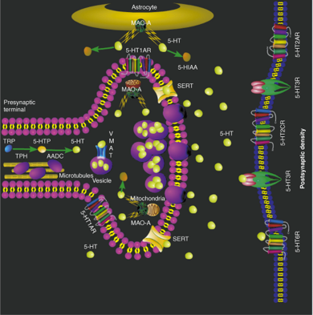
Mechanisms of aggression – in humans
MAOA gene → MAO-A protein
MAO-A breaks down…neurotransmitters
Serotonin and norepinephrine
Mice without MAOA gene have way more serotonin and norepinephrine
These mice are also extra aggressive and have heightened fear response
Behavioral differences seem to be due to effects of extra serotonin during development (not an adult issue)
What happens in your past affects your future
Brunner et al 1993
Buckholtz & Meyer-Lindenberg 2008
Notes:
Caspi et al 2002: In MAOA gene, variable number of repeates in a section of the gene are associated with MAOA-L (low MAOA expression) and MAOA-H (high MAOA expression). MAOA-L males who were abused early in life were more likely to have antisocial behavior as adults relative to MAOA-H males.

Slide 17
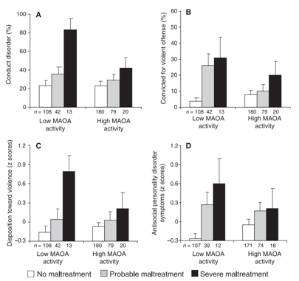
Mechanisms of aggression – in humans
MAOA gene → MAO-A protein
MAO-A breaks down…neurotransmitters
Serotonin and norepinephrine
Mice without MAOA gene have way more serotonin and norepinephrine
These mice are also extra aggressive and have heightened fear response
Behavioral differences seem to be due to effects of extra serotonin during development (not an adult issue)
What happens in your past affects your future
An additional mutation in this gene partially mediates the relationship between early-life adversity and adult outcome (Caspi et al 2002)
Brunner et al 1993
Buckholtz & Meyer-Lindenberg 2008

Slide 18
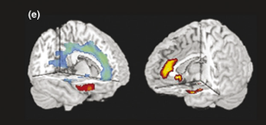
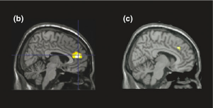
Mechanisms of aggression – in humans
Neuroanatomy and neural activity of men with Low vs High MAOA activity
Low = more serotonin; High = less serotonin
Less grey matter in MAOA-Low men
When looking at angry and fearful face, MAOA-Low men had higher activity in amygdala and insula brain regions and lower activity in ventromedial prefrontal cortex
Amygdala = ‘fear processing’ region
Prefrontal cortex = decision-making, processing
Also saw greater connectedness between amygdala, another area of prefrontal cortex (with the highest serotonin density!), and cingulate in MAOA-Low men
Hypothesis: Amygdala-cingulate-ventromedial prefrontal cortex circuit is involved with social evaluation and emotion processing.
Buckholtz & Meyer-Lindenberg 2008
Notes:
Figure 2. Allelic variation at the MAOA u-VNTR affects brain structure and function. (a) Areas of altered gray matter volume, notably in amygdala, in Turner syndrome
females (45,X) compared to healthy females (46,XX) [40]. (b) Anterior cingulate hypoactivation during an fMRI cognitive control task in participants carrying the lowexpressing
MAOA u-VNTR allele (MAOA-L) compared to those carrying the high-expressing MAOA u-VNTR allele (MAOA-H) [38]. (c) Exaggerated anterior cingulate
response during social rejection in MAOA-L subjects which was linked to increased interpersonal sensitivity and aggression [81]. (d) Diminished ventrolateral prefrontal
cortex engagement during response inhibition in MAOA-L individuals [39]. (e) (left) Areas of decreased gray matter in MAOA-L subjects (blue) and regions of increased gray
matter in MAOA-L men (red). (e) (right) Regions of aberrant functional activation during emotional face processing in MAOA-L subjects [42]. (f) A ventromedial prefrontalcingulate-
amygdala circuit for social decision making and emotion regulation that is compromised in MAOA-L males. In this model, validated by path analysis,
ventromedial prefrontal cortex acts as a superordinate regulatory node to provide compensatory support to rostral cingulate, a primary negative regulator of amygdala
activation during emotional arousal that is structurally and functionally compromised in MAOA-L males [50].

Slide 19
Mechanisms of aggression – in humans
Buckholtz & Meyer-Lindenberg 2008
Notes:
Figure 3. Depiction of the interactions between MAOA u-VNTR genotype and early-life experience in predicting adult antisocial behavior. The low-expressing MAOA
uVNTR allele (first column) leads to elevated serotonin levels during ontogeny (second column). This excess serotonin during development adversely impacts an
amygdala-cingulate-vmPFC circuit for social evaluation and emotion regulation – the ‘socioaffective scaffold’ (third column). Labilization of this circuitry by excess serotonin
diminishes resilience and amplifies the influence of early-life environment (fourth column) on subsequent adult aggressive behavior (fifth column). Rows 1 and 3
demonstrate that risk for adult aggressive behavior is low in individuals who possess a high-expressing MAOA allele, whether or not they experience an abusive (row 1) or
nonabusive (row 3) upbringing. Rows 2 and 4 show that in individuals with a low-expressing MAOA allele, risk for adult violence is greater in those who experience earlylife
abuse (row 2) compared to those who do not (row 4).

