Slide 1
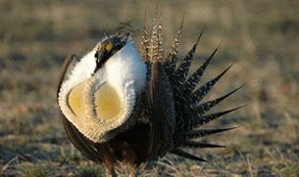
Mating!
Week 8
Foundations of Animal Behavior
Emily Levy
Some slides adapted from Susan Alberts
Notes:
Sage grouse: US FWS and Mark Gocke/Vanuga Photography©
Superb bird of paradise: Cornell lab of ornithology
North American Habronattus jumping spider: Thomas Shahan
Baboon: Jeanne Altmann
Jacanas mating: Cherie Pittillo
Mandrill: monkeyworlds.com

Slide 2
Learning outcomes
Understand the pros and cons of sexual reproduction
Understand the essential theory of sexual selection
Understand the diversity of mating systems
Identify how ecology can drive the evolution of mating systems

Slide 3
https://www.youtube.com/watch?v=v_BurGW2rPU

Slide 4
Why reproduce sexually?

Slide 5
Why not reproduce asexually?
Bacteria can reproduce super fast (asexually)
https://www.youtube.com/watch?v=gEwzDydciWc

Slide 6
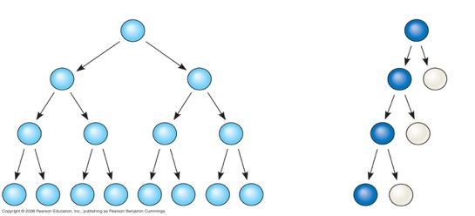
What are the costs of sexual reproduction?
Requires extra machinery
Can break up adapted genotypes
Offspring has only 50% of parent’s genome, not 100%
Reduces number of descendants you can produce
Asexual reproduction
Sexual reproduction

Slide 7
What are the costs of sexual reproduction?
Requires extra machinery
Can break up adapted genotypes
Offspring has only 50% of parent’s genome, not 100%
Reduces number of descendants you can produce
Yet, nearly all plants, fungi and animals reproduce sexually! Why?
Asexual reproduction
Sexual reproduction

Slide 8
What’s the benefit of sexual reproduction?
Recombination during meiosis!
gamete
gamete

Slide 9
What’s the benefit of sexual reproduction?
Recombination during meiosis!
& Combining two gametes to form zygote
+
gamete
gamete
zygote
Remember: parents looked like this:

Slide 10
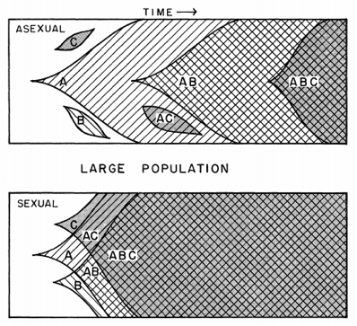
What’s the benefit of sexual reproduction?
Recombination during meiosis!
& Combining two gametes to form zygote
→Quickly end up with new combinations of alleles
More rapidly lose deleterious mutations
More rapidly accumulate beneficial mutations
FYI: On average, each human is born with ~100 new mutations.
Crow & Kimura 1965
Notes:
Xue et al. 2009, Current Biology 19:1453

Slide 11
2 types of sexual reproduction
Isogamy = all gametes same size
Fungi & protists
Notes:
Protists include algae, amoebas, slime molds, diatoms
Fungus: Steve Axford
Paramecium caudatum: John J Lee

Slide 12
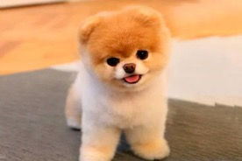
2 types of sexual reproduction
Isogamy = all gametes same size
Fungi & protists
Anisogamy = two different sizes
Eg, sperm and egg or pollen and ovule
All animals and plants!
Notes:
Protists include algae, amoebas, slime molds, diatoms
Fungus: Steve Axford
Paramecium caudatum: John J Lee

Slide 13
2 types of sexual reproduction
Isogamy = all gametes same size
Fungi & protists
Anisogamy = two different sizes
Sperm/pollen and egg
All animals and plants!
Male = smaller gamete
Female = larger gamete
Notes:
Mamothmemore.net
Webmd

Slide 14
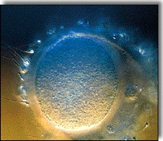
Why two sexes? (How did anisogamy evolve?)
Prevailing hypothesis:
Sexual reproduction is a very ancient evolutionary event.
It evolved when organisms were ‘broadcast spawners.’
Assume gamete survival depends on gamete size (i.e., gamete food reserves):
select for large gametes.
Smaller gametes will be at a disadvantage:
selection to seek out larger gametes to fuse with.
→ Selection for smaller and faster gametes among the ‘small types’ and larger, slower gametes among the ‘large types.’
Parker et al. 1972, J. Theor. Biol 36:529.

Slide 15
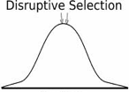
Why two sexes? (How did anisogamy evolve?)
Prevailing hypothesis:
Disruptive selection – selection for a bimodal distribution of gamete size, large and small
Gametes specialize in:
Storing energy reserves (large)
Seeking out and parasitizing energy reserves (small)
Females usually invest more per fertilized egg than males
Isogamy
Anisogamy
Parker et al. 1972, J. Theor. Biol 36:529.

Slide 16
Females’ greater investment means that…
1. Female has disproportionate control over production and fate of offspring.
which male fertilizes the female’s gametes
how much the resulting zygotes are protected
how much the resulting zygotes are nourished
Notes:
NPS, US FWS, Alan Hill

Slide 17
Females’ greater investment means that…
1. Female has disproportionate control over production and fate of offspring.
2. After mating, males return to the “available mating pool” more rapidly than females.
Operational Sex Ratio (OSR) is skewed towards males

Slide 18
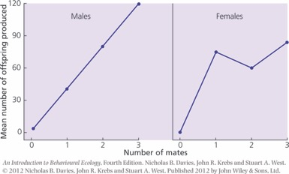
Females’ greater investment means that…
1. Female has disproportionate control over production and fate of offspring.
2. After mating, males return to the “available mating pool” more rapidly than females.
3. Males generally gain additional offspring with each additional mating; this is not as true for females.
Also more variation in reproductive success in males than females
‘Bateman’s Principle’

Slide 19
Females’ greater investment means that…
1. Female has disproportionate control over production and fate of offspring.
2. After mating, males return to the “available mating pool” more rapidly than females.
3. Males generally gain additional offspring with each additional mating; this is not as true for females.
4. Males experience strong selection to influence the reproductive decisions and reproductive outcomes of females
Traits that influence the reproductive decisions of females will experience sexual selection

Slide 20
Take-aways about sexual reproduction
Main costs: slower & less relatedness
Main benefit: new combinations of alleles, faster evolution
Anisogamy (large & small gametes) = females invest more per fertilized egg than males
In effect, females and males tend to fill different mating ‘niches’
Females control offspring, are hung up with them longer than males. Males may gain more by mating multiply, and experience selection to appeal to females

Slide 21
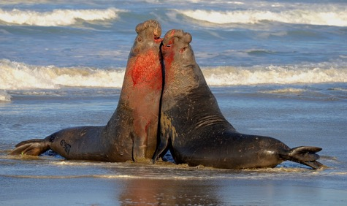
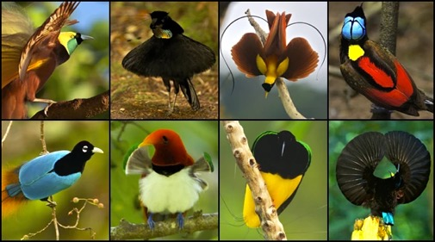
Sexual Selection
Notes:
Cornell lab of ornithology
Ari Friedlaender

Slide 22
Sexual selection
Selection on traits that influence an organism’s ability to acquire mates or produce zygotes (fertilized eggs) with those mates
Traits that influence the reproductive decisions of the opposite sex will experience sexual selection
Notes:
Cornell lab of ornithology
Ari Friedlaender

Slide 23
Some sexually-selected traits
Improve a male’s ability to fend off other males from females (weapons + large bodies)
Notes:
Evgeny Melnikov
Leslea Hlusko

Slide 24
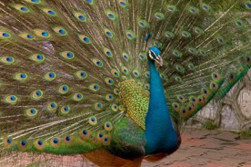
Some sexually-selected traits
Improve a male’s chance of being chosen by a female
Ornaments, displays, gifts
Peacocks: females prefer males with more spots on the tail.
Blue-backed manakin: elaborate mating display
Arctic tern: males provide ‘nuptial gifts’.
Notes:
Female arctic terns more likely to pair & be ‘faithful’ with a male that brings fish during courtship

Slide 25
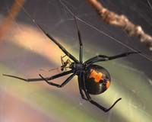
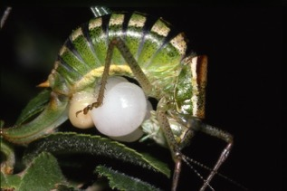
Some sexually-selected traits
Present nutritional resources to the female to enhance the nutrition of the eggs
Australian redback spider: male catapults his body into the jaws of the female after mating.
Bushcricket: female with spermatophore given by male

Slide 26
Some sexually-selected traits
Sperm competition
Sperm speed, sperm size, testis size
1 male & 1 female
1 male & many females
Many males & many females
Notes:
With sperm competition, the idea is that males don’t compete – or don’t only compete -- before copulation, but that the sperm of multiple males may encounter each other in the female’s reproductive tract after copulation. In this context, males with more or faster sperm will experience advantages in fertilization, selecting for large quantities or fast swimming sperm.
Figure adapted from Dixson 2012: Primate Sexuality: Comparative Studies of the Prosimians, Monkeys, Apes and Human Beings. Adapted by psychology today https://www.psychologytoday.com/intl/blog/how-we-do-it/201805/do-men-have-the-balls-promiscuity

Slide 27
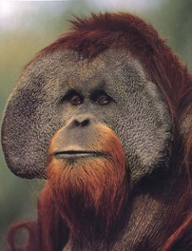
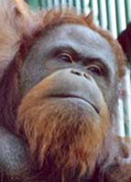
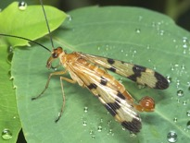
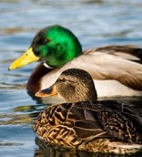
Some sexually-selected traits
Behaviors that result in sexual conflict
Harassment of females and attempts to force or coerce copulation
Scorpionflies: large males provide nuptial gifts, small males attempt to force copulation
Mallard ducks: males will sometimes force copulation with unpaired females
Orang utans: large (“flanged”) males are preferred by females; small (“unflanged”) males attempt to force copulation

Slide 28
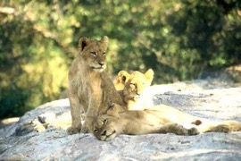
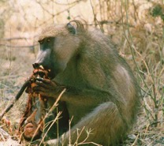
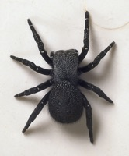
Some sexually-selected traits
Behaviors that result in sexual conflict
Infanticide and feticide
Lions
Many primates
Eresid spiders

Slide 29
Some sexually-selected traits
Increase ability to fend off other males (large or weapons)
Increase attractiveness to females (ornaments, displays, gifts)
Present nutrition for eggs
Sperm competition
Sexual conflict

Slide 30
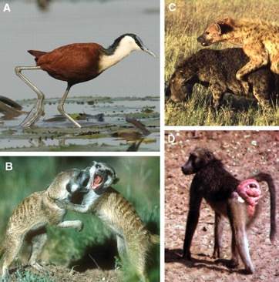
Do females experience sexual selection?
Yes!
They are less obvious
Anisogamy → lower variance in reproductive success among females than males
Females gain less by influencing males
Less gain = weaker sexual selection…
But not absence
Clutton-Brock 2007
Notes:
Figure Caption: In many animals, competition between females for breeding opportunities is intense, and females show pronounced secondary characters. In polyandrous birds, where males invest heavily in parental care, females compete intensely more frequently for breeding opportunities than males and are commonly larger than males as in (A) female African jacana (Actophilornis africanus). Female competition for breeding opportunities is also intense in a number of social mammals where female rank and breeding success are closely correlated, including (B) Kalahari meerkats (Suricata suricatta) and (C) spotted hyenas (Crocuta crocuta). Females have developed pronounced secondary sexual ornaments that attract males in some polygynous or promiscuous species, including (D) savannah baboons (Papio cynocephalus). In a number of birds, both sexes have similar ornaments probably as a result of mutual mate-choice, while in a few species, males and females display in different sites and have developed contrasting coloration. [Credits: (A and B) A. Young; (C) M. L. East and H. Hofer; (D) T. Clutton-Brock]

Slide 31
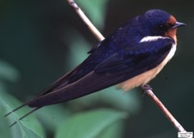
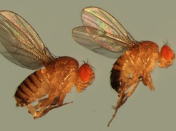
Why was Darwin worried about sexual selection?
Sometimes, sexual selection seems to act in opposition to natural selection
Barn swallow; Tail streamer length
Reproductive success
Survival
Sexually-selected trait
(eg, body size)
Fruitfly; Wing length

Slide 32
So does sexual selection ‘work’? Can being a choosy female help?
If males provide an honest signal of quality/condition…
Then being choosy can result in higher fitness
Signal can be handicaps (peacock) or positively correlated (sedge warbler)
Sometimes males provide good resources
Sometimes males provide good genes

Slide 33
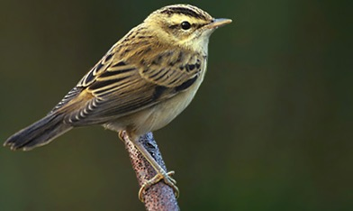
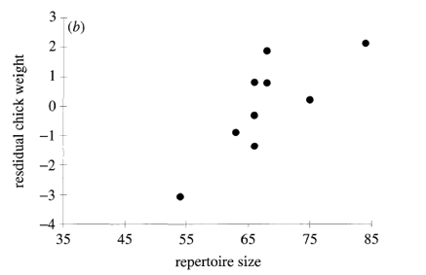
Choosing good males via positive correlation
Sedge warbler
Buchanan & Catchpole 2000

Slide 34
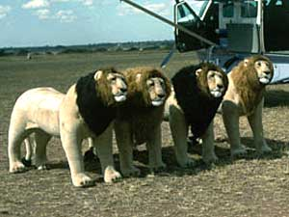
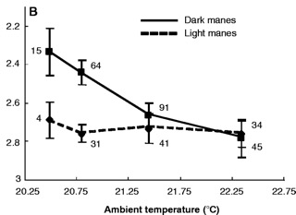
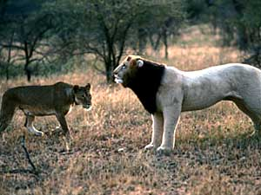
Choosing good males who provide good resources via handicap
Belly size
Core body temp
Darkness of mane
Ambient temperature (C)
Dark-maned males eat more during cooler season
Dark-maned males experience heat stress
In hot years, all males have lighter manes
Dark-maned males also had higher T and retained territories longer than light-maned males
West and Packer 2002

Slide 35
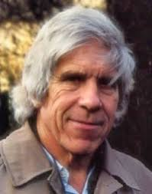
Choosing males who provide good genes
Hamilton-Zuk Hypothesis:
Expression of particular male traits reflects his ability to resist parasites
Males with better parasite resistance have more elaborate, intense, or extreme traits
Resistance to pathogens depends on genes that are passed on to offspring (ie, ‘good genes’)
So, females prefer males with these elaborate traits
This hypothesis makes a lot of sense, but evidence is scattered
Marlene Zuk
Bill Hamilton

Slide 36
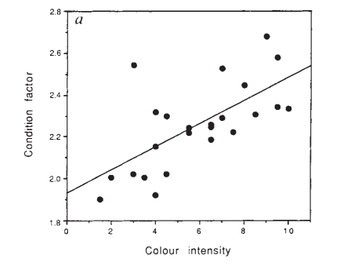
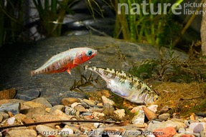
Choosing males who provide good genes
Hamilton-Zuk Hypothesis:
1. Color intensity is linked to body condition
Condition (body mass index)
Three-spined sticklebacks
Color intensity
Milinski and Bakker 1990

Slide 37
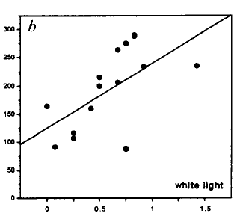
Choosing males who provide good genes
Hamilton-Zuk Hypothesis:
2. Females prefer males with more intense red
Strength of female preference
Three-spined sticklebacks
Color intensity
Milinski and Bakker 1990

Slide 38
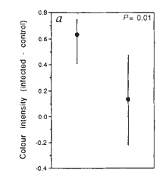
Choosing males who provide good genes
Hamilton-Zuk Hypothesis:
3. Parasitization reduces male color intensity
Color intensity
Three-spined sticklebacks
Parasitization
Before
After
Milinski and Bakker 1990

Slide 39
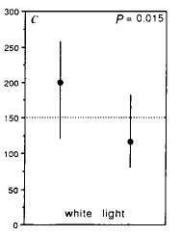
Choosing males who provide good genes
Hamilton-Zuk Hypothesis:
4. Females lose interest in males after parasitization
Female preference
Three-spined sticklebacks
Parasitization
Before
After
Milinski and Bakker 1990

Slide 40
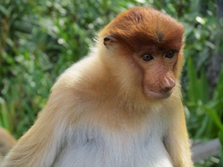
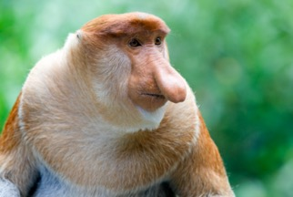
Choosing males who provide good genes
Genes can increase sexual attractiveness of their sons
Fisherian ‘runaway selection’
By choosing males with a particular trait (eg, long noses), females select for (1) males with that trait and (2) females preference for males with that trait.
Eventually, males with that trait have higher mating success
Can result in extreme morphological or color differences between sexes

Slide 41
How females can choose males
Good resources
Traits in male may positively correlate with his ability to provide parental care
Traits in male may be hard to bear, indicating that he’s high quality
Good genes
Hamilton-Zuk: parasite resistance
Runaway selection / Sexy sons

Slide 42
Mating Systems & the Socioecological Model

Slide 43
Mating system terms
Mono = 1
Poly = many
Gynous = females
Androus = males
Monogamous = 1 female, 1 male
Polygynous = many females, 1 male
Polyandrous = many males, 1 female
Polygynandrous/polygamy = many females & many males

Slide 44
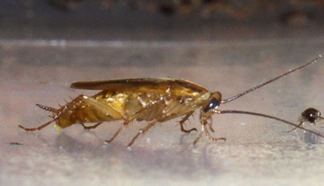
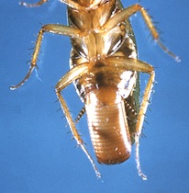
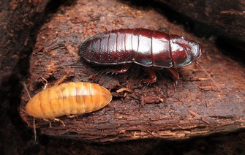
Mating system diversity
German cockroach
Gregarious
Males emit sex pheromones to attract females to mate
Both sexes mate mutliply
Females and males both provide nutrients to the eggs, and females carry the egg case in their body until hatching.
No post-hatching parental care.
Wood roach
Monogamous pairs form and stay together for extended periods
Both parents assist in parental care of young

Slide 45
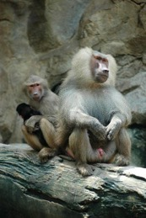
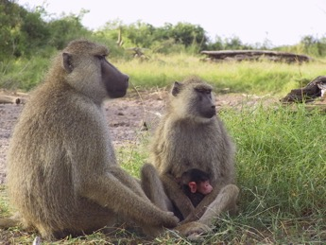
Mating system diversity
Hamadryas baboons
Single males with 1-4 females (OMUs)
Females monogamous, males polygynous
Males maintain very close social bonds and close proximity to females regardless of female reproductive state, these bonds are permanent.
Males provide indirect and possibly direct care to offspring, extent unknown
OMUs come together at sleeping cliffs in aggregations of many hundreds
Yellow baboons
Multi-male, multi-female groups of about 60-80 animals.
Polygynandrous mating (both sexes mate with multiple partners)
Males mate guard intensively when females are in estrous
No permanent male-female bonds but males provide some paternal care
Social groups avoid each other

Slide 46
Mating system diversity
Hamadryas baboons
Single males with 1-4 females (OMUs)
Females monogamous, males polygynous
Males maintain very close social bonds and close proximity to females regardless of female reproductive state, these bonds are permanent.
Males provide indirect and possibly direct care to offspring, extent unknown
OMUs come together at sleeping cliffs in aggregations of many hundreds
What explains this diversity of mating systems???
Yellow baboons
Multi-male, multi-female groups of about 60-80 animals.
Polygynandrous mating (both sexes mate with multiple partners)
Males mate guard intensively when females are in estrous
No permanent male-female bonds but males provide some paternal care
Social groups avoid each other

Slide 47
Socioecological model
Socio → social behavior
Ecological → driven by environment
Model → conceptual, simplified notion of a system

Slide 48
Socioecological model
Emlen & Oring 1977
There’s a limiting sex (usually females) and a limited sex (usually males)
Limiting sex doesn’t usually benefit from having >1 mate
Ecological resources determine where on the landscape the limiting sex is
Aggregate around a resource? Scattered across landscape? In small clumps?
Ecological resources determine the synchronicity of breeding (for females)
Ecological resources will partly determine whether offspring need care from 0, 1, or 2 parents
The effect of ecology on the limiting sex determines the behavior of the limited sex as well

Slide 49
Socioecological model via ecology
Distributed (difficult to defend) resources and partners
Clumped (easy to defend) resources and partners
Completely synchronous and seasonal
Continuous and asynchronous
Lots from both parents
None
Monogamy
Polygamy
Monogamy
Polygamy
Monogamy
Polygamy
What is the economic distribution of resources?
How synchronous is breeding?
How much care do offspring need?
Notes:
Reiterate that resources determine how females are distributed on the landscape (single vs. clumped), how females time reproduction (synchronous vs. asynchrounous) and how much care offspring need. Females map on to resources, males map onto females.

Slide 50
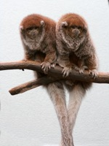
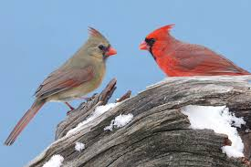
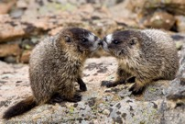
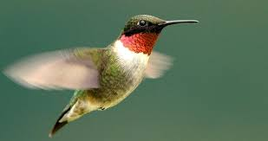
Socioecological model via females
Females spatially stable in/around resource
Males pursue a resource
defense strategy
Resources (and females) dispersed
OR
Offspring need paternal care
Resources (and females) clumped and offspring require little/no paternal care
Males monogamous
Males polygynous
Many songbirds, gibbons, titi monkeys
Most hummingbirds, many other birds, yellow-bellied marmots, many other mammals

Slide 51
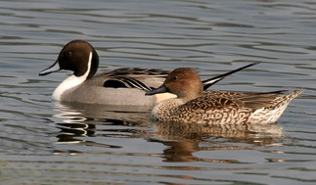
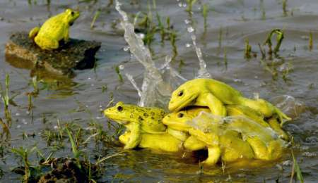
Females continually move (not spatially stable)
Males pursue a mate defense strategy
Females dispersed and synchronously breeding
Females clumped, may or may not be synchronous
1. In small, stable groups
Males monogamous
Ducks and geese
"Harems"
2. In large, stable groups
Hamadryas baboons
Multimale polygyny
3. In small, unstable groups
Yellow baboons
Sequential polygyny
4. In large, unstable groups and highly synchronous
Woodcocks, elephants
Scramble competition polygyny
Anuran spp, 13-lined ground squirrels

Slide 52
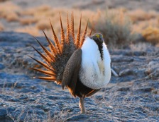
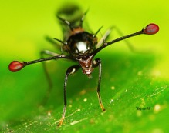
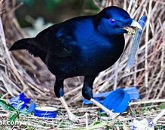
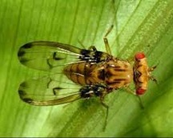
Females are dispersed, not spatially stable, and reproduce asynchronously
Males in leks
(a “display site defense strategy”)
Many kinds of grouse, bowerbirds, manakins, some cichlid fish, many insects including stalk-eyed flies, Hawaiian Drosophila
Notes:
Sage grouse lek: https://www.youtube.com/watch?v=VyVy7P7cRs0
Lance-tailed manakin lek: https://www.youtube.com/watch?v=6V9FZSDmR1U
Bird of paradise: https://www.youtube.com/watch?v=bbLpZn4B7b0

Slide 53
Females spatially stable in/around resource
Females continually move (not spatially stable)
Males pursue a resource
defense strategy
Males pursue a mate defense strategy
Females dispersed
OR
Offspring need paternal care
Females clumped and offspring require little/no paternal care
Females dispersed, don’t exhibit strong mate choice
Females clumped
1. In small, stable groups
Males monogamous
Males polygynous
Males monogamous
Many songbirds, gibbons, titi monkeys
Yellow-bellied marmots,
Orange-rumped honeyguide
Ducks and geese
"Harems"
2. In large, stable groups
Gorillas, ele-phant seals
Multimale polygyny
3. In small, unstable groups
Females are dispersed, not spatially stable, and reproduce asynchronously
Savannah ba-boons, cape buffalo
Sequential polygyny
4. In large, unstable groups
Males in leks
(a “display site defense strategy”)
Woodcocks, elephants
Many kinds of grouse, bowerbirds, some cichlid fish, many insects including Hawaiian Drosophila
Scramble competition polygyny
Anuran spp, 13-lined ground squirrels
Notes:
What unifies all this diversity is the three dimensions among which female distributions will vary.

Slide 54
Socioecological take-away
Ecology is the bedrock
Female behavior depends on the ecology
Some behaviors better suited to some environments
Male mating behavior depends on females

Slide 55
Two more classes!
Fighting
Animal emotion/lives of our pets?
Email me: What do you want to hear about during our last class?

