Slide 1
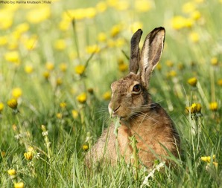
Eating & Not Getting Eaten (aka, Staying Alive)
Week 7
Foundations of Animal Behavior
Emily Levy
Notes:
Left: NB Hunter

Slide 2
Learning outcomes
Understand traits and behaviors that animals have evolved to avoid predation – and interactions between those traits and behaviors
Understand basics of foraging theory, including main factors
Analyze plot of ‘real’ foraging data from class

Slide 3
Outline
Not getting eaten
Predator avoidance alone
Predator avoidance in a group
Eating (and finding food)
Optimal foraging activity

Slide 4
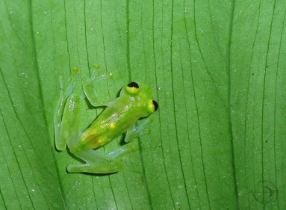
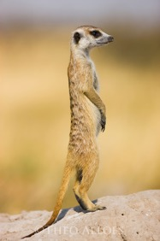
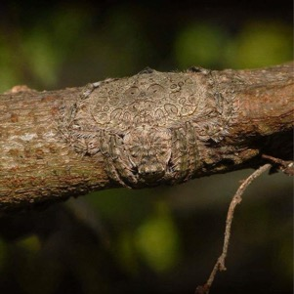
Not getting eaten
Aka, Predator avoidance
Notes:
Octopus: © Brandon Cole
Frog: https://www.emaze.com/@AWOTOIFQ
Spider: © dustaway

Slide 5
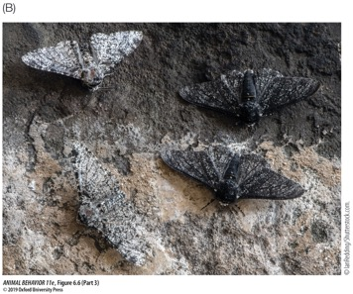
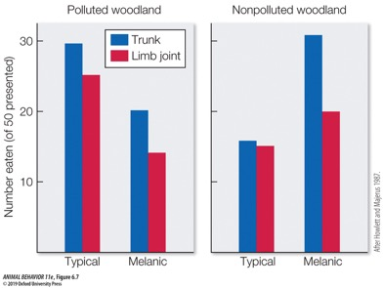
Avoiding predators alone
Blending in (crypsis)
How you look
What you do
https://www.youtube.com/watch?v=GFUiCsUSzyw

Slide 6
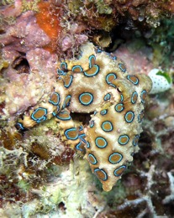
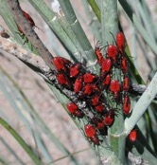
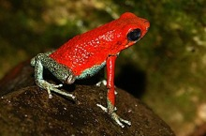
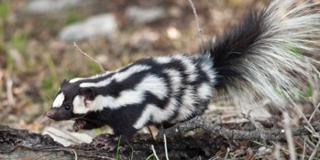
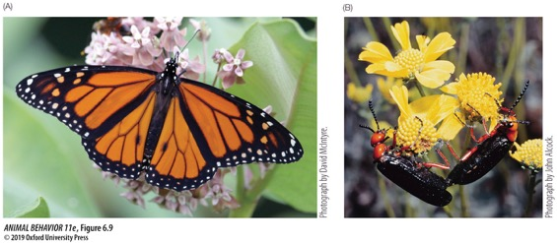
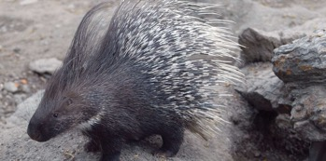
Avoiding predators alone
Standing out
Aposematic = showing warning coloration
Notes:
FIGURE 6.9 Warning coloration and toxins. Animals that are chemically defended typically are conspicuous in appearance and behavior. (A) Monarch butterflies that feed on toxic milkweeds as caterpillars store the cardiac glycosides acquired from their food in their bodies and wings when they become adults. (B) Blister beetles, which have blood laced with cantharidin, a highly noxious chemical, often mate conspicuously for hours on flowering plants. (A, photograph by David McIntyre; B, photograph by John Alcock.)

Slide 7
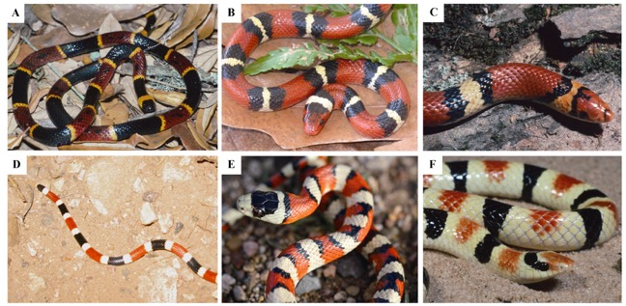
Avoiding predators alone
Standing out
Aposematic = showing warning coloration
Room for defectors!
Batesian mimicry = looking like an unpalatable species when you’re perfectly palatable
Notes:
Pfennic & Kikuchi 2012: Competition and the evolution of imperfect mimicry
“Variation in degree of mimetic resemblance among coral snake mimics A. In the southeastern U.S., venomous eastern coral snakes Micrurus fulvius serve as models to two species of Batesian mimics. B. Scarlet kingsnakes Lampropeltis elapsoides and (C) scarlet snakes Cemophora coccinea. D. In the southwestern U.S., venomous Sonoran coral snakes Micruroides euryanthus serve as models to several Batesian mimics, including (E) Sonoran Mountain kingsnakes Lampropeltis pyromelana and (F) Western shovel-nosed snakes Chionactis occipitalis. Not only do different species of mimics vary in how closely they resemble their model (as illustrated in these examples), but different conspecific populations of mimetic species vary in mimetic fidelity (see main text). A, C, F courtesy of Wayne Van Devender; B, D, E by David Pfennig.

Slide 8
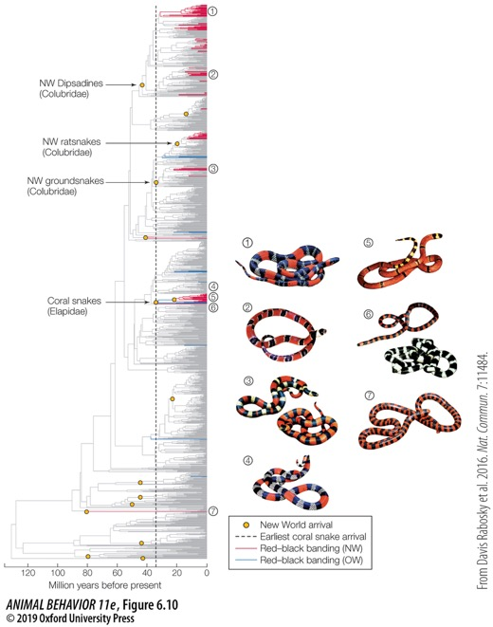
Avoiding predators alone
Standing out
Aposematic = showing warning coloration
Room for defectors!
Batesian mimicry = looking like an unpalatable species when you’re perfectly palatable
Notes:
FIGURE 6.10 Batesian mimicry occurs in New World snakes. Red–black banded coloration has evolved independently at least 26 times across snakes, including six times outside of New World colubrids and elapid coral snakes. Numbers denote phylogenetic placement of corresponding snake images. Some nonpoisonous colubrid and non-colubrid snakes mimic the coloration of elapid coral snakes, which are poisonous. OW, Old World; NW, New World. (From Davis Rabosky et al. 2016, CC BY 4.0.)

Slide 9
Avoiding predators alone
Standing out
Aposematic = showing warning coloration
Room for defectors!
Batesian mimicry = looking like an unpalatable species when you’re perfectly palatable
And room for cooperation!
Müllerian mimicry = multiple unpalatable species look alike
Notes:
Axel Meyer(2006) Repeating Patterns of Mimicry. PLoS Biol 4(10): e341/Public Library of Science

Slide 10
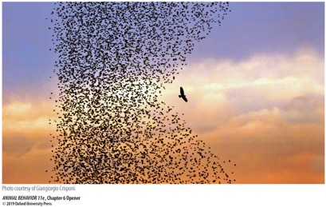
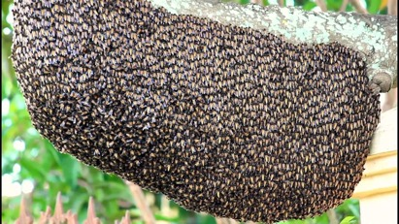
Avoiding predators in social groups
Once you’re in a group, tactics must shift
Active
We’ve already discussed an example!
Mobbing is common defense strategy – gulls, whales, wasps, bees
Can be costly
More mobbing could sometimes mean more predation
Notes:
(c) Don Metzner

Slide 11
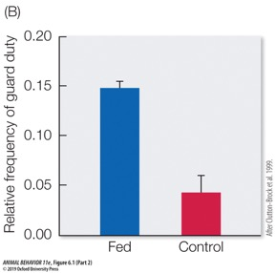
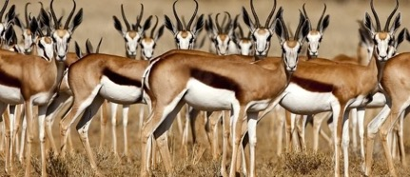
Avoiding predators in social groups
Once you’re in a group, tactics must shift
Active
More eyes for increased vigilance
More eyes = better spotting overall. Or…
More eyes = share the work, and less spotting needed overall
Notes:
©Theo Allofs
Meerkats fed eggs were 3x more likely to go on sentinel duty

Slide 12
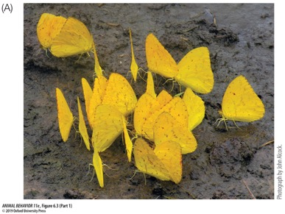
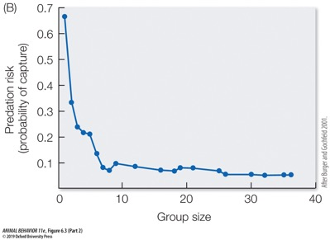
Avoiding predators in social groups
Once you’re in a group, tactics must shift
Passive defenses
When are passive defenses beneficial? 3 hypotheses:
Dilution effect: Unlikely that any 1 individual will be eaten
Notes:
Dilution effect: Probably especially effective when aggregations are transient; number of predators won’t increase. Example: butterfly ‘puddling’

Slide 13
Avoiding predators in social groups
Once you’re in a group, tactics must shift
Passive defenses
When are passive defenses beneficial? 3 hypotheses:
Dilution effect: Unlikely that any 1 individual will be eaten
Confusion effect: Moving in a group makes it hard for predators to single out and catch prey
Notes:
More predatory hawks ~ larger, denser starling flocks and more flying together ~ reduced (human) ‘predation’
© nick Dunlop – see here for many more of his incredible photos! https://www.audubon.org/magazine/winter-2017/hungry-raptors-make-murmurations-even-more

Slide 14
Avoiding predators in social groups
Once you’re in a group, tactics must shift
Passive defenses
When are passive defenses beneficial? 3 hypotheses:
Dilution effect: Unlikely that any 1 individual will be eaten
Confusion effect: Moving in a group makes it hard for predators to single out and catch prey
Selfish herd: Group/herd is by-product of individuals putting others between them and a predator (Hamilton 1971)
These 3 hypotheses are not mutually exclusive!

Slide 15
Eating
(aka, Foraging)

Slide 16
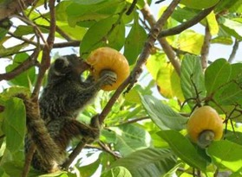
Foraging foundations
Food = energy
Key factors of foraging:
Travel distance or search time (traveling from one fruit tree to another)
Pursuing time or energy (finding the ripe fruit)
Processing time or handling time (picking and eating the fruit)
Food density
Food quality

Slide 17
Optimal foraging theory
Identifies predictions for how animals should forage to optimize their energy balance (and fitness)
Optimizing energy gain per cost
Cost = Time and/or energy spent
Keep eating this food or move on to another food source?
Keep eating here or move to another patch of the same food?
How to optimize the probability of coming into contact with food?

Slide 18
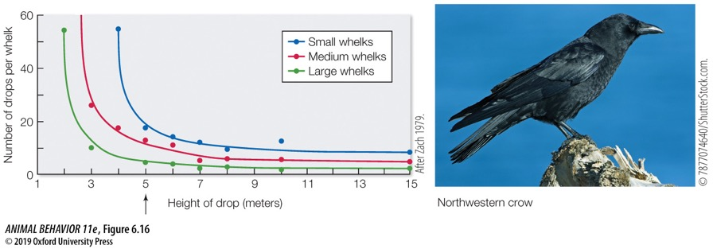
Optimal foraging theory put to work
Northwestern crows pick up whelks, fly up ~5m, and drop them to break them
Notes:
FIGURE 6.16 Optimal foraging decisions by northwestern crows when feeding on whelks. The curves show the number of drops at different heights needed to break whelks of different sizes. Northwestern crows pick up only large whelks, increasing the calories available to them, and they drop their whelks from a height of about 5 meters (indicated by the arrow), thereby minimizing the energy they expend in opening their prey. (After Zach 1979; photograph © 7877074640/ShutterStock.)

Slide 19
Optimal foraging theory put to work
Blue whales diving for krill
Notes:
Mechanics, hydrodynamics and energetics of blue whale lunge feeding: efficiency dependence on krill density
J. A. Goldbogen, J. Calambokidis, E. Oleson, J. Potvin, N. D. Pyenson, G. Schorr, R. E. Shadwick
Journal of Experimental Biology 2011 214: 131-146; doi: 10.1242/jeb.048157

Slide 20
Optimal foraging activity!
Notes:
http://people.eku.edu/ritchisong/behavecolnotes2.htm

Slide 21
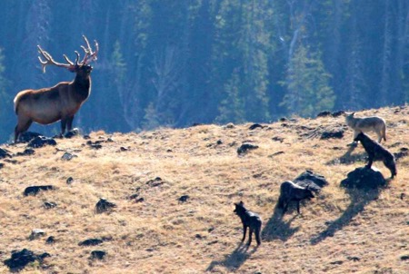
Putting it together: Eating AND not getting eaten

Slide 22
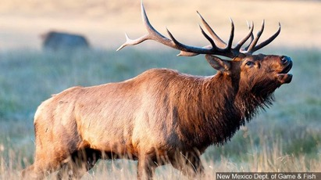
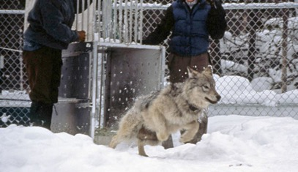
Eating AND not getting eaten: Yellowstone National Park
ELK
Browse on aspen and willow leaves & branches
Wolves are main predator
WOLVES
Extirpated in ~1930s
Re-introduced in 1995
Notes:
Wolf photo: NPS Jim Peaco

Slide 23
Eating AND not getting eaten: Yellowstone National Park
Notes:
Trophic cascades in Yellowstone: The first 15 years after wolf reintroduction
WJ.Ripple, Robert L.Beschta
Ripple, W. J., & Beschta, R. L. (2004). Wolves and the ecology of fear: can predation risk structure ecosystems?. BioScience, 54(8), 755-766.

Slide 24
Eating AND not getting eaten: Yellowstone National Park
Notes:
Trophic cascades in Yellowstone: The first 15 years after wolf reintroduction
WJ.Ripple, Robert L.Beschta

Slide 25
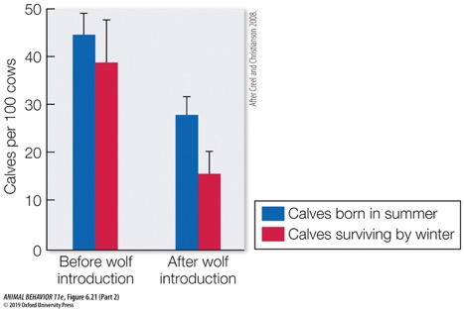
Eating AND not getting eaten
Notes:
FIGURE 6.21 Foraging decisions are often affected by predator pressure. After wolves were reintroduced into the Yellowstone ecosystem, elk spent more time hidden in woodlands rather than feeding in exposed meadows. This change reduced the production of calves by elk cows (blue bars) and decreased the survival of the calves they did have (red bars). Bars depict mean +/– 95 percent confidence intervals. (After Creel and Christianson 2008; photograph © iStock.com/mlharing.)
Diel predator activity drives a dynamic landscape of fear
Michel T. Kohl et al

