Slide 1
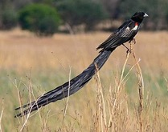
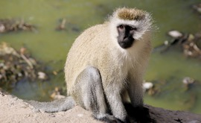
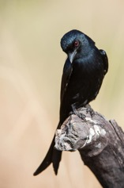
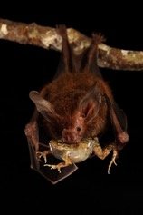
Communication
Week 6
Foundations of Animal Behavior
Emily Levy
Some slides adapted from Susan Alberts and Matthew Zipple, Eleanor Caves & Patrick Green

Slide 2
Learning outcomes
Understand different types of animal communication and how thye can evolve
Analyze methods and results of a study
Understand the concept of honest signals and ways they are maintained

Slide 3
Outline
Basics of communication
Name that mode of communication!
Evolution of communication
Honest signals
& How they are maintained

Slide 4
https://www.youtube.com/watch?v=0nfgibIYbg8

Slide 5
Basics of communication

Slide 6
Communication
‘the transfer of information from one individual to another that affects current or future behavior and the fitness of one or both individuals’
-Rubenstein & Alcock, Animal Behavior 2019

Slide 7
Communication
Why send a message?
Why receive a message?
Why respond to a message?
How can communication evolve?
Both signaler and recipient must, on average, benefit from the communication in order for it to evolve
Why?
How can eavesdropping evolve?

Slide 8
Matrix of communication
Exploitation/deception
Signal
PRODUCER
RECEIVER
Eavesdropping/interception
Signals
Exploitation/Deception
Eavesdropping/Interception
Slide adapted from Caves, Green & Zipple
Notes:
Our point is that there are benefits and costs to all of this
- These are all going to be in “fitness terms” – mating benefits, social costs, predation costs.
Put up the concepts and the axes – ask the class to place each concept on the plot (doesn’t need to be group activity).

Slide 9
Defining terms
Exploitation/
deception
Signal
Signals
Producer and receiver both benefit
Exploitation/deception
Producer benefits, receiver doesn’t
Eavesdropping/interception
Receiver benefits, producer doesn’t
PRODUCER
RECEIVER
Eavesdropping/
interception
Slide adapted from Caves, Green & Zipple

Slide 10
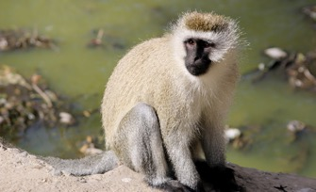
Name that mode of communication!
Read through study and data
Figure out what they did and found
Discuss questions in green
Each group will share their study with the class

Slide 11
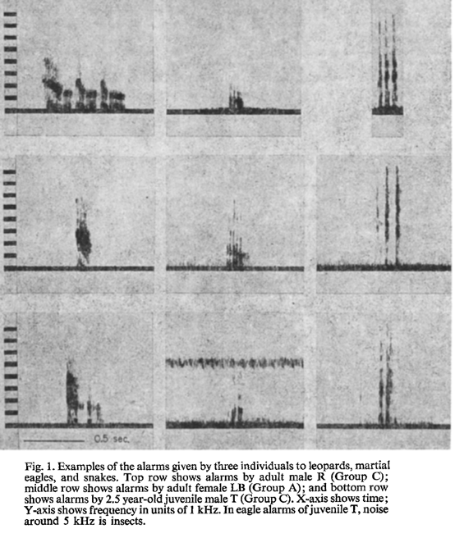
When leopard present
When eagle present
When snake present
Vervet alarm calls
Adult male calls →
Frequency of the sound →
Time →
Do you think these calls are reliable?
Who produces reliable calls?
Who receives these calls?
Who’s benefitting?
Adult female calls →
Juvenile male calls →
Seyfarth Cheney & Marler 1980

Slide 12
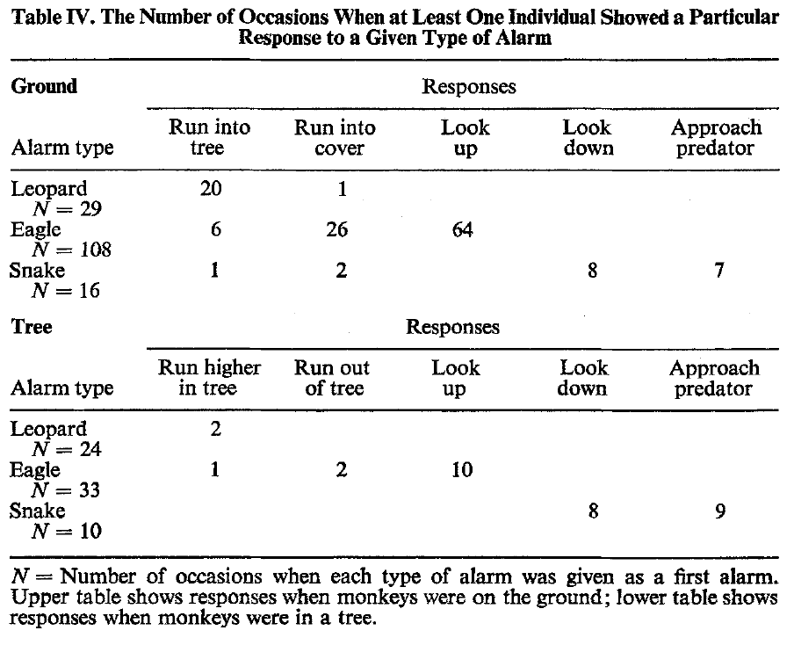
Alarm happened while vervets were on the ground
Alarm happened while vervets were in a tree
Seyfarth Cheney & Marler 1980

Slide 13
Matrix of communication
Exploitation/deception
Signal
PRODUCER
RECEIVER
Eavesdropping/interception
Signals
Exploitation/Deception
Eavesdropping/Interception
Slide adapted from Caves, Green & Zipple
Notes:
Our point is that there are benefits and costs to all of this
- These are all going to be in “fitness terms” – mating benefits, social costs, predation costs.
Put up the concepts and the axes – ask the class to place each concept on the plot (doesn’t need to be group activity).

Slide 14
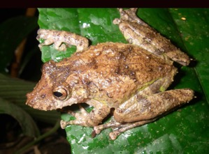
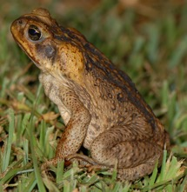
Frog-eating bats and their prey
Potential prey:
Predator:
HUGE frog, Leptodactylus pentadactylus, similar song to P. Pustulosus
Palatable túngara frog, Physalaemus pustulosus
Fringe-lipped bat, Trachops cirrhosus
Palatable frog, Hyla boulengeri
Poisonous toad Bufo marinus, similar in size to H. boulengeri
Tuttle & Ryan 1981

Slide 15
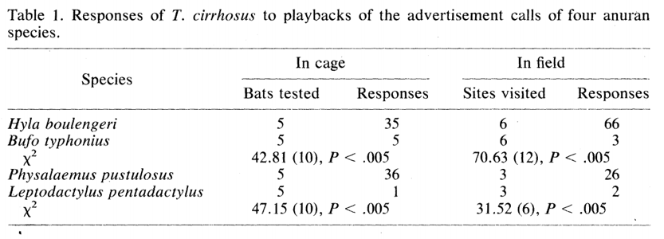
Frog-eating bats and their prey
P. Pustulosus call behavior | # Bat fly-bys per prey capture (smaller = more captured)
Full chorus (all calling) | 1.8
Partial chorus | 2.3
Few calling | 3.4
None calling | 42.7
Who do the bats prefer to capture?
How do the bats find their prey?
Are the frogs producing reliable signals?
Who’s benefitting?
Stats showing that bat responses differed between the pair above
Tuttle & Ryan 1981

Slide 16
Matrix of communication
Exploitation/deception
Signal
PRODUCER
RECEIVER
Eavesdropping/interception
Signals
Exploitation/Deception
Eavesdropping/Interception
Slide adapted from Caves, Green & Zipple
Notes:
Our point is that there are benefits and costs to all of this
- These are all going to be in “fitness terms” – mating benefits, social costs, predation costs.
Put up the concepts and the axes – ask the class to place each concept on the plot (doesn’t need to be group activity).

Slide 17
Drongos & meerkats
Drongos are birds who are great at mimicking other sounds and who feed on insects. The are solitary but tend to forage around other species, including meerkats. Meerkats recognize their alarm call that there’s a predator around.
Drongo alarm calls are sometimes real…
Drongos imitating the alarm calls of other bird species…
‘True’ alarm calls in response to predators
‘False’ alarm calls for kleptoparasitism
‘True’ mimicked alarm calls
‘False’ mimicked alarm calls
Flower 2010

Slide 18
Drongos & meerkats
Meerkat response to drongo alarm calls. Calls were either ‘True’ (drongos were calling in response to a predator), ‘False’ (drongos were calling in the absence of a predator), or ‘Non-alarm’.
Results:
“When following target species, drongos kleptoparasitized food items from them including insect larvae, reptiles, scorpions and crickets, contributing an average 22 ± 4% to biomass intake per focal drongo.
Sometimes drongos stole food by attacking targets (52 ± 8% of kleptoparasitisms). However, in 48 ± 8% of kleptoparasitisms drongos made false alarm calls from a perch when a target was handling a food item.
In 31 ± 5% of these false alarms drongos exclusively made drongo-specific alarm calls; in 42 ± 6% drongos exclusively made suspected mimicked alarm calls; and in 27 ± 6% drongos made a combination of both drongo-specific and suspected mimicked alarm calls.
Target individuals fled to cover in response to false alarm calls in 211/258 (82%) cases, leaving their food behind on 140/258 (54%) occasions, enabling the drongo to fly down and steal it. ”
Do drongos produce reliable signals?
Who’s benefitting?
Do the meerkats ever benefit from this?
How could this communication evolve?
Flower 2010

Slide 19
Matrix of communication
Exploitation/deception
Signal
PRODUCER
RECEIVER
Eavesdropping/interception
Signals
Exploitation/Deception
Eavesdropping/Interception
Slide adapted from Caves, Green & Zipple
Notes:
Our point is that there are benefits and costs to all of this
- These are all going to be in “fitness terms” – mating benefits, social costs, predation costs.
Put up the concepts and the axes – ask the class to place each concept on the plot (doesn’t need to be group activity).

Slide 20
Long-tailed widowbirds
Background:
Male widows have extremely long tailfeathers (~50 cm long)! They mate with multiple females, and usually females who mate with a male will then build a nest on his territory.
Methods:
Andersson found nine sets of four male widowbirds and created four conditions:
1. Short tail: cut the tailfeathers so they are 14cm long
2. Long tail: Glue the feathers on so they’re 25cm longer than before
3. Length control: Nothing changed
4. Glue control: Cut the feathers and glue them back on (no change in length)
Andersson recorded mating displays and territorial disputes both before and after glueing
Are longer tailfeathers in males an honest signal of quality?
Why or why not?
Are longer tailfeathers in males good for anything?
What (if anything) would drive selection for these long tailfeathers?
Andersson 1982

Slide 21
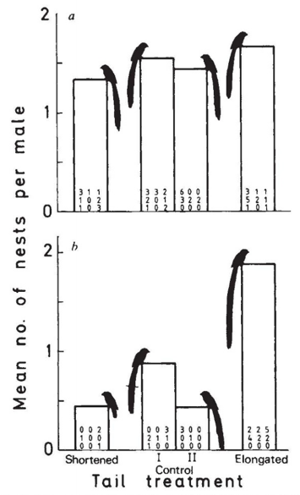
Long-tailed widowbirds
Mating success before tailfeather adjustment
Are longer tailfeathers in males an honest signal of quality? Why or why not?
Are longer tailfeathers in males good for anything?
What (if anything) would drive selection for these long tailfeathers?
Mating success after tailfeather adjustment
Andersson 1982

Slide 22
Matrix of communication
Exploitation/deception
Signal
PRODUCER
RECEIVER
Eavesdropping/interception
Signals
Exploitation/Deception
Eavesdropping/Interception
Slide adapted from Caves, Green & Zipple
Notes:
Our point is that there are benefits and costs to all of this
- These are all going to be in “fitness terms” – mating benefits, social costs, predation costs.
Put up the concepts and the axes – ask the class to place each concept on the plot (doesn’t need to be group activity).

Slide 23
Evolution of communication

Slide 24
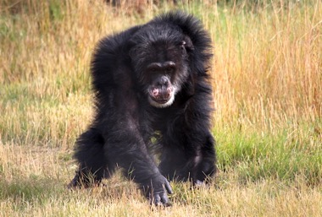
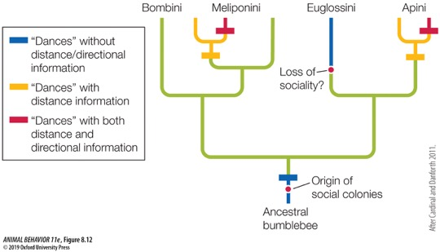
Evolution of communication requires one of the following:
1. Preexisting trait of sender
Anything that provides information to receivers
Sender benefits from receiver’s response
→ Ritualization
Eg raising hair when facing a threat
Note: Must be received!!
Can use comparative techniques to trace evolution of communication

Slide 25
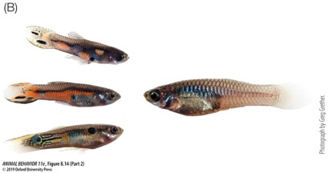
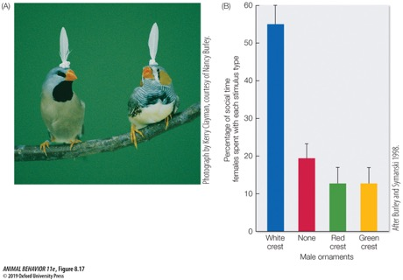
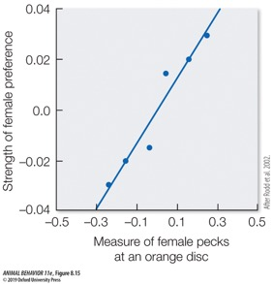
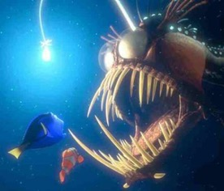
Evolution of communication requires one of the following:
2. Preexisting bias of the receiver
Sensory system of receiver is ‘primed’ to receive such a signal
‘Sensory exploitation’
‘Sensory trap’
Notes:
FIGURE 8.14 Food, carotenoids, and female mate preferences in the Trinidadian guppy. (A) Males have to acquire orange pigments from the foods they eat, such as this Clusia fruit that has fallen into a stream where the guppies live. Males that secure sufficient amounts of carotenoids incorporate the chemicals into ornamental color patches on their bodies. (B) Females (such as the larger fish on the right) find males with large orange patches more sexually appealing than males without them. (Photographs by Greg Grether.)

Slide 26
Signals

Slide 27
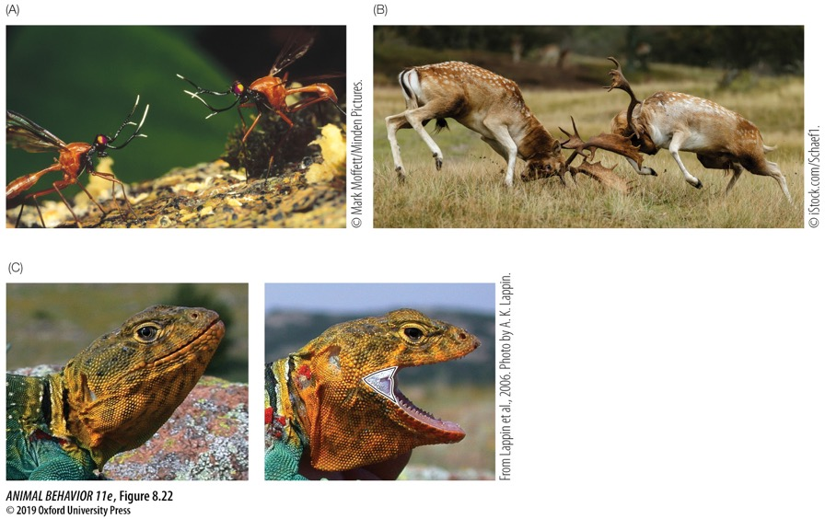
Fighting ability
Notes:
FIGURE 8.22 Honest visual signals of size and strength. (A) Males of this Australian antlered fly in the genus Phytalmia confront each other head to head, permitting each fly to assess his own size relative to the other’s size. (B) Antler size in male fallow deer (Dama dama) provides information about male fighting ability. (C) The larger the patch of ultraviolet-reflecting skin by the open mouth of a gape-displaying collared lizard, the harder the reptile can bite an opponent. The UV-reflecting skin is outlined in the image on the right. (A, photograph © Mark Moffett/Minden Pictures; B, photograph © iStock.com/Schaef1; C from Lappin et al. 2006; photograph by A. K. Lappin.)

Slide 28
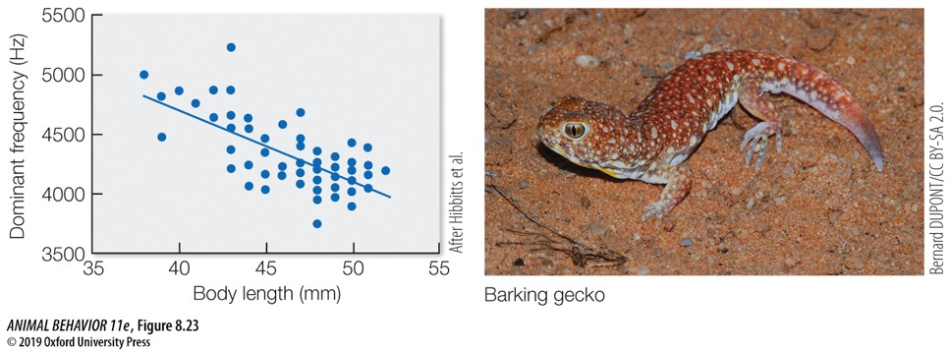
Body size
Notes:
FIGURE 8.23 Honest acoustic signals of size in a barking gecko. The larger the male, the lower the frequency of his calls. (After Hibbitts et al. 2007; photograph Bernard Dupont/CC BY-SA 2.0.)

Slide 29
Dominance
Notes:
FIGURE 8.26 Honest visual signals of dominance in the paper wasp Polistes dominula. In this species, dominance is linked to dark patches on the face of the wasp. Notice the variation among wasps in the size of black patch from left (where it is completely absent) to right (where there is nearly as much black as yellow). (Photographs courtesy of Elizabeth Tibbetts.)

Slide 30
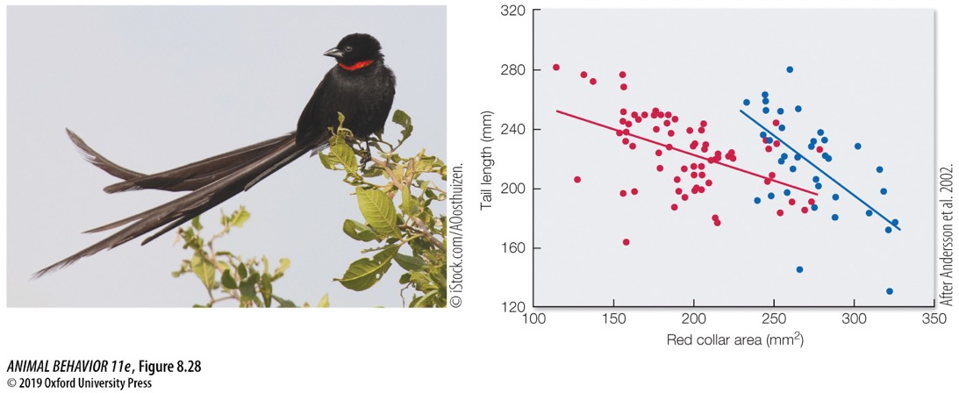
Multiple signals!
Don’t have territories
Have territories
Notes:
FIGURE 8.28 Signal trade-off between tail length and collar area in red-collared widowbirds. There was a negative relationship between the size of the male’s red collar and the length of his tail. The trends were similar for territory-holding “resident” males (blue circles) and non-territory-holding “floater” males (red circles). (After Andersson et al. 2002; photograph © iStock.com/AOosthuizen.)

Slide 31
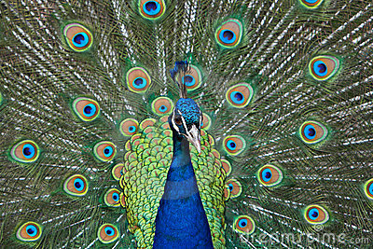
The evolutionary logic of signaling
If signals are not honest or reliable indicators of some benefit to the receiver, then selection will shape receivers to ignore them.
So in general we expect signals to be honest.
Blue peafowl, Pavo cristatus
Notes:
Watch video: https://www.youtube.com/watch?v=qDvFdj-pFMc

Slide 32
What keeps signals honest?
But the first signaler in a communication system to send a dishonest signal will benefit from doing so.
Thus, there is strong selection pressure on signalers to cheat (send dishonest signals).
So, what keeps signals honest?
Blue peafowl, Pavo cristatus

Slide 33
What keeps signals honest?
Three potential mechanisms
The signal is an index of ability, strength, or size
https://www.youtube.com/watch?v=JJiF42aguYY
Male red deer ‘roar’ to attract mates.
Females prefer lower frequency roars.
The frequency of the roar depends on the length of the vocal tract.
Vocal tract length depends on body size
I.e., the frequencies of a male’s roar (the ‘formants’) are constrained by his body size
The frequencies of the roar are an index of body size
Notes:
Watch these videos: https://www.youtube.com/watch?v=PMbpdL762JQ
https://www.youtube.com/watch?v=97ORGksHhKw

Slide 34
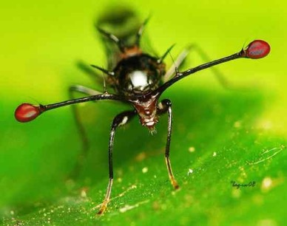
What keeps signals honest?
Three potential mechanisms
The signal is a handicap
A handicap differs from an index in that it is condition-dependent (not size-dependent).
Only animals in good condition can exhibit it.
This is because the trait is especially expensive to produce and/or maintain.
Male stalk-eyed fly, Teleopsis breviscopium

Slide 35
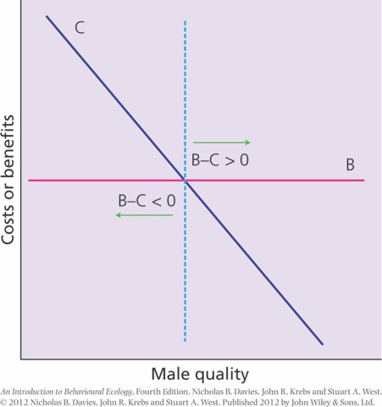
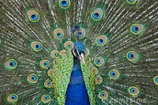
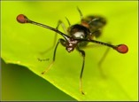
The handicap principle – condition-dependent traits
For high-quality individuals, B >> C
For low-quality individuals, B << C

Slide 36
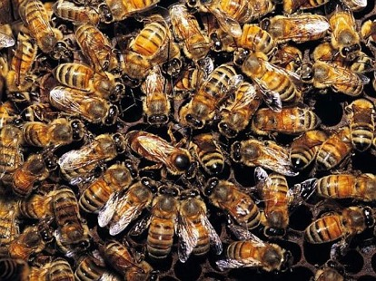
What keeps signals honest?
Three potential mechanisms
The sender and receiver share a common interest in the signal (i.e., they both receive the same benefit if the signal is honest)
The evolutionary logic of sending a signal is that it can influence the behavior of others to further the signaler’s self-interest.
The evolutionary logic of responding to a signal is to further the receiver’s self-interest
If the interests of signaler and receiver are identical, there is no selection to cheat (send a dishonest signal
Honeybees, Apis mellifera
Notes:
Watch video: https://www.youtube.com/watch?v=-7ijI-g4jHg
For a slightly longer video (7 min) watch: https://www.youtube.com/watch?v=bFDGPgXtK-U – start at 1:15 and go to 2:30 or so

Slide 37
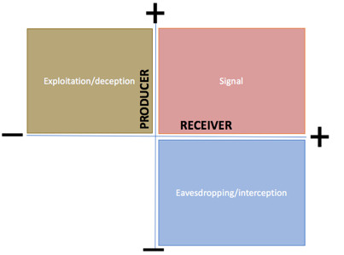
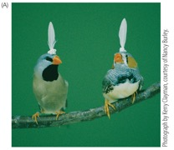
Wrap-up
Communication comes in many forms
Signals benefit both sender and receiver
Communication can evolve via preexisting traits in sender or preexisting bias in receiver
Signals can be kept honest by directly indexing quality, by being a handicap, or by being part of a shared trait

