Slide 1
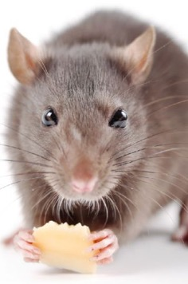
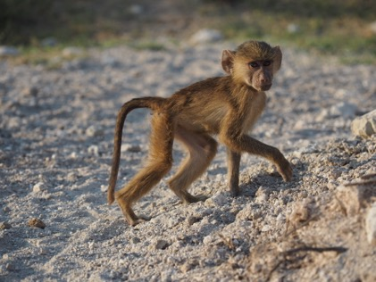
How your past affects your future: Early life effects
Week 5
Foundations of Animal Behavior
Emily Levy

Slide 2
https://www.youtube.com/watch?v=SO1WccH2_YM

Slide 3
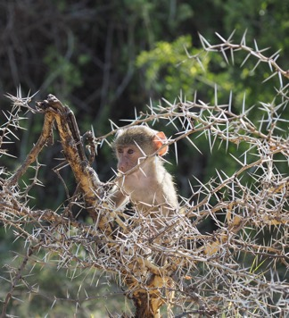
Learning outcomes
Describe examples of early-life effects
Understand mechanisms of early-life effects
Understand two main theories of early-life effects
Discuss differences between these two theories in an evolutionary context

Slide 4
Outline
A few concepts
The classics
Two theories about early-life effects
https://www.youtube.com/watch?v=FzIKuu0oAtU

Slide 5
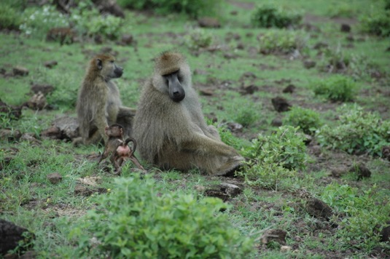
A few concepts

Slide 6
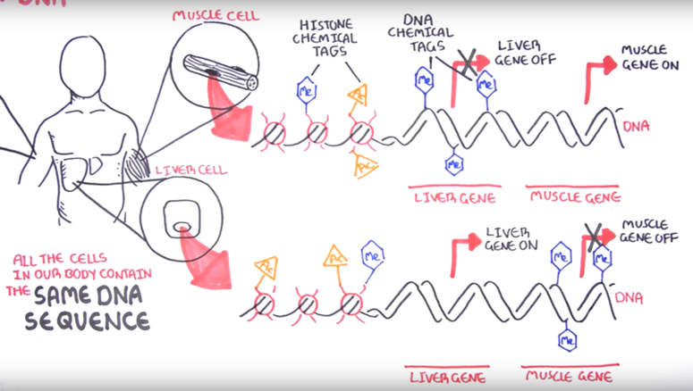
Epigenetics 101
For helpful video see https://www.youtube.com/watch?v=JMT6oRYgkTk

Slide 7
Phenotypic plasticity (can only get you so far)
One species of grasshopper!
Fed on plant with toxins that they keep
Fed on plant without toxins
Sword 1999 2002; Monaghan 2008

Slide 8
The classics

Slide 9
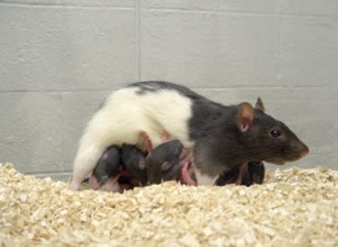
Licking and grooming in rats
Rat moms vary in how much they lick and groom offspring (maternal care)
Does quantity of maternal care affect offspring as adults?
YES!
Pups who receive more licking and grooming are less nervous
They also have lower cortisol (glucocorticoid) levels
Why?
Licking and grooming in early life increases glucocorticoid receptor density in the brain, which helps control a negative feedback loop
Changes in receptor density are due to epigenetic effects: licking & grooming demethylate (ie, ‘shut off’) a promotor region of the glucocorticoid receptor gene
Injecting methylation goo into brains reverses effect
And those effects are passed on to grandkids
Females who received lots of licking and grooming as pups also licked an groomed their own pups more
Liu et al 1997; Francis et al 1999; Meaney 2005

Slide 10
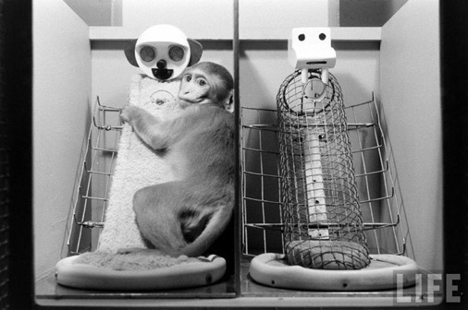
Cloth monkey, wire monkey
Harlow & Harlow 1962, 71
Demonstrated intense effects of lack of social environment, and
Retrieval of nearly-normal social behavior from very little social interaction (15 mins/day with peers)

Slide 11
Cumulative early adversity in baboons

Slide 12
Dutch hunger winter
Dutch hunger winter 1944-45
750 calories/day; urban women had low birth weight babies
Some health effects, but perhaps not as much as you might think
But show differences in methylation in genes associated with metabolism and growth (Tobi et al 2018)
% Methylation
Notes:
(a) A lowess curve depicting the average within-pair difference (y axis) stratified by the estimate of the start of pregnancy (LMP; x axis). Each coloured line represents an individual P-DMR. (b) the blue bars depict the official daily rations (kcal per day) per week, the black line represents a lowess curve depicting the average 24 h temperature (source KNMI; DeBilt weather station). The daily requirement of (non-pregnant) women of 2,000 kcal per day is denoted in red.

Slide 13
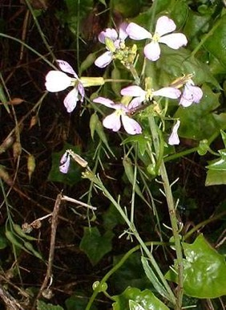
Two theories about how your past affects your future

Slide 14
Predictive-adaptive response
Adjust your development so that your traits are suited to your adult environment
Requires the ability to predict (so you can respond adaptively)
Environmental cue
Poor early environment
Good early environment
Fitness
Poor adult environment
Good adult environment

Slide 15
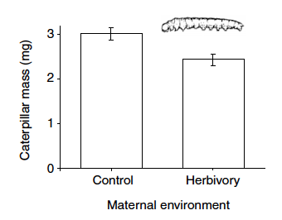
Predictive-adaptive response
“Inducible defenses may provide an adaptive defensive strategy in which non-lethal cues from predators, herbivores, or parasites provide a reliable indicator about the future risk of attack.” (Agrawal et al 1999)
Wild radishes eaten by caterpillars
When plants exposed to heavy herbivory, their seeds (offspring) contained more defense chemicals
The plants whose parents had heavy herbivory were more resistant to herbivory themselves
Agrawal et al 1999
Notes:
Example: showshoe hares, GCs & predation (Boonstra 1998); possible mechanism: GCs

Slide 16
Predictive-adaptive response
Daphnia (water fleas)
Predators release kairomones that daphnia can sense
When kairomone concentration is high, daphnia develop large helmets
Daphnia with larger helmets were ~3-9x less likely to be eaten
Then tested whether effect is transmitted maternally or via environment
Agrawal et al 1999
Notes:
Example: showshoe hares, GCs & predation (Boonstra 1998); possible mechanism: GCs

Slide 17
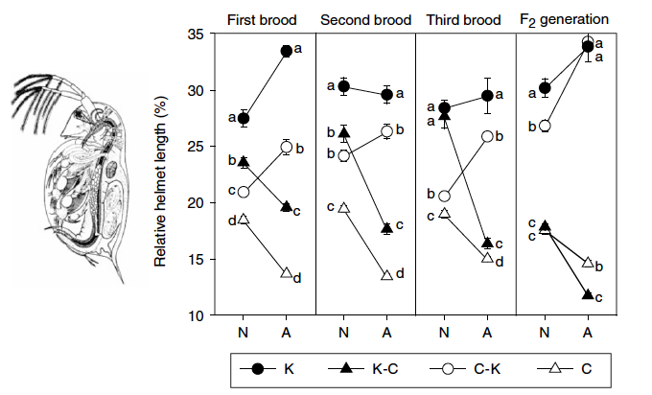
Agrawal et al 1999
Is helmet development determined by maternal effects or by early-life environment?
YES!
Baby → Adult
C: Mom and offspring developed in safe water
C-K: Mom developed in safe water, offspring developed in predator juice water
K: Mom and offspring developed in predator juice water
K-C: Mom developed in predator juice, offspring developed in ‘safe’ water

Slide 18
Agrawal et al 1999
Is helmet development determined by maternal effects or by early-life environment?
Baby → Adult
Baby → Adult
C: Mom and offspring developed in safe water
C-K: Mom developed in safe water, offspring developed in predator juice water
K: Mom and offspring developed in predator juice water
K-C: Mom developed in predator juice, offspring developed in ‘safe’ water

Slide 19
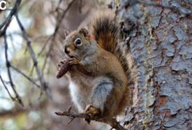
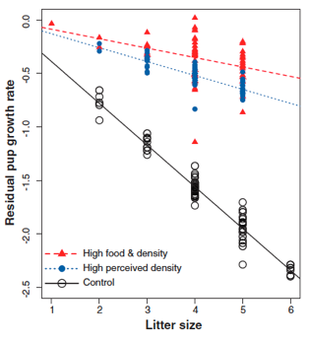
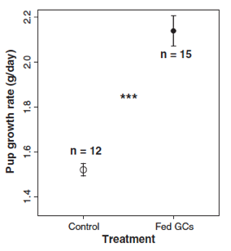
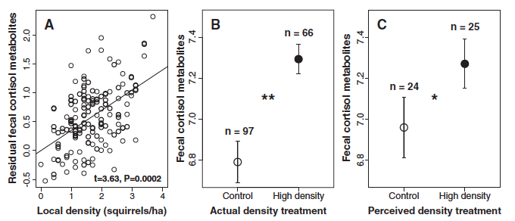
Predictive-adaptive response
Females in higher perceived or actual density had offspring that grew faster than females in low density
Females in higher perceived or actual density had higher GCs than females in low density
Females fed GCs had pups who grew faster than females who weren’t fed GCs
Dantzer et al 2013

Slide 20
Developmental constraints
Aka silver spoon model
Growing up in tough conditions is costly
Individuals who experience early-life adversity are developmentally constrained and end up with poorer adult phenotype
Good early environment
Poor early environment
Fitness
Poor adult environment
Good adult environment

Slide 21
Predictive-adaptive response vs. Developmental constraints
Can be hard to tell apart, especially in humans!
Good early environment
Fitness
Poor early environment
Poor adult environment
Good adult environment
Notes:
Humans who grow up with nutrient limitations (poor early environment) and are not nutrient-limited as adults (good adult environment) have poor health, suggestive of PAR
BUT, we don’t know if those who experienced poor early environment would do better in poor adult environment than those who had good early environment

Slide 22
Demonstrating developmental constraints
Really bad drought in Amboseli from 2008-2009 → natural experiment
Track reproductive success in each female during the drought and before/after (in high-rainfall years)
Know each female’s early-life environment
Predictive adaptive response
Prediction: females born during low-rainfall years will show a smaller decrease in reproduction during a drought year than females born during high-rainfall years
Developmental constraints
Prediction: females burn during low-rainfall years will show a greater decrease in reproduction during a drought year than females born during high-rainfall years
Lea et al 2015

Slide 23
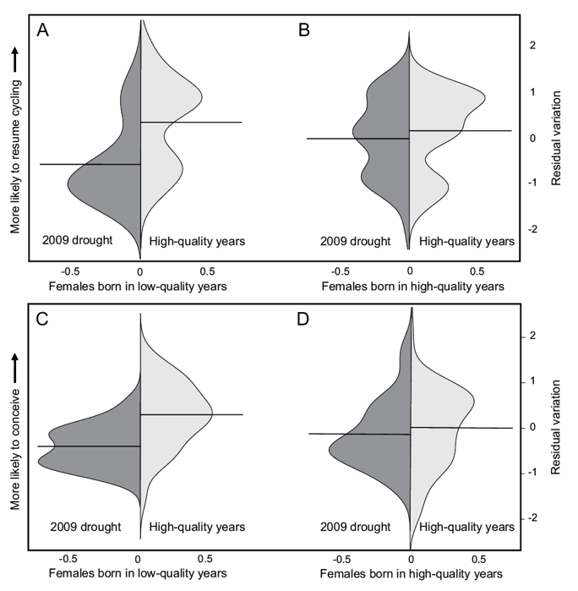
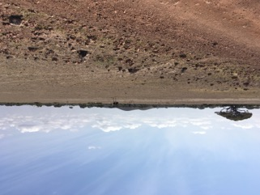
Demonstrating developmental constraints
Lea et al 2015

Slide 24
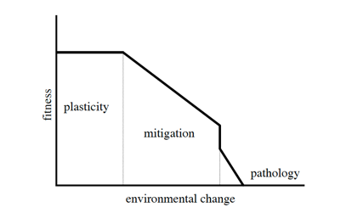
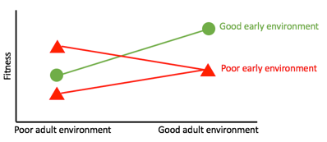
Predictive-adaptive response vs. Developmental constraints
Why is it hard to distinguish between the two?
When might we expect one to play out versus the other?
What do you think happens in humans?
In what way is the developmental constraints model adaptive?

