Slide 1
Cooperation
Week 4
Foundations of Animal Behavior
Emily Levy

Slide 2
Learning outcomes
Understand diverse forms and drivers of cooperation
Discuss cooperative behavior in evolutionary context
Play prisoner’s dilemma simulation to understand evolutionary stable strategies for cooperation

Slide 3
Outline
Tree of cooperation (5:30-6:10)
Simulation: Evolution of Trust (6:10-6:40)
Case study: Vampire bats (6:40-7:00)

Slide 4
Tree of cooperation
Video: https://www.youtube.com/watch?v=8wl8ZxAaB2E

Slide 5
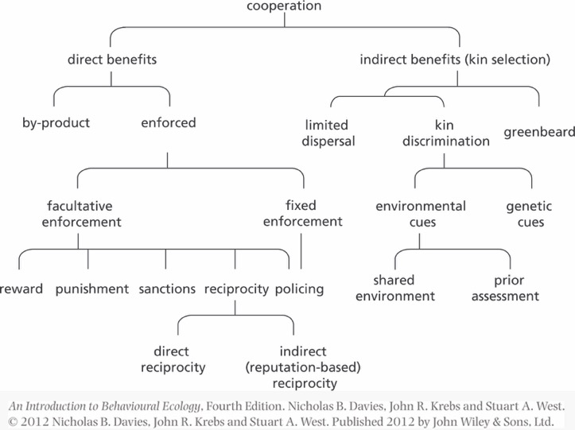
So many ways to cooperate!

Slide 6
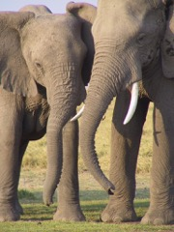
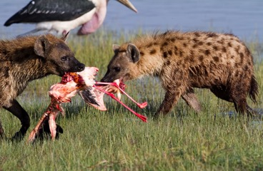
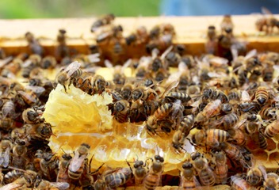
What did Darwin have to say about cooperative behavior?
"He who was ready to sacrifice his life…rather than betray his comrades, would often leave no offspring to
inherit his noble nature.”
Darwin 1871, The Descent of Man

Slide 7
What did Darwin have to say about cooperative behavior?
…one special difficulty, which at first appeared to me insuperable, and actually fatal to my whole theory:
…the neuters or sterile females in insect communities:
…being sterile they cannot propagate their kind.
Darwin 1859, Origin of Species, Chapter VII

Slide 8
What did Darwin have to say about cooperative behavior?
"This difficulty, though appearing insuperable, … disappears, when it is remembered that selection may be applied to the family, as well as to the individual…
…breeders of cattle wish the flesh and fat to be well marbled together; the animal has been slaughtered, but the breeder goes with confidence to the same family.
This is the basis of the idea of kin selection.
Darwin 1859, Origin of Species, Chapter VII

Slide 9
The basis for kin selection: Average genetic relatedness in diploid organisms Diploid = 2 copies of each chromosome
Relationship | Relatedness (% genes shared)
Parent-offspring | 0.5
Full siblings | 0.5
Half-siblings Aunt-full niece Grandparent-Grandchild | 0.25 0.25 0.25
Full first cousins Aunt-half niece | 0.125 0.125
Notes:
Graphic: https://genetics.thetech.org/ask-a-geneticist/human-neanderthal-similarity-africans-europeans

Slide 10
The basis for kin selection: Average genetic relatedness in haplodiploid organisms Haplodiploid = Males have 1 copy of chromosome, Females have 2
Relationship | Relatedness (% genes shared)
Mom-daughter Mom-son | 0.5 0.5
Full sisters | 0.75
Half sisters | 0.25

Slide 11
Relatedness & evolution of kin selection
Hamilton’s Rule: r*b > c OR r > c/b
r = Relatedness between give and receiver
b = Benefit to receiver
c = Cost to giver
If you share “enough genes” with the recipient, then it makes sense to contribute to their welfare at some cost to yourself, because by doing so you will propagate your own genetic material.
W.D. Hamilton

Slide 12
“Would I lay down my life to save my brother?
No, but I would lay down my life to save two brothers or eight cousins.”
JBS Haldane

Slide 13
So many ways to cooperate!
YOU’RE TRAPPED!
(but with your family)

Slide 14
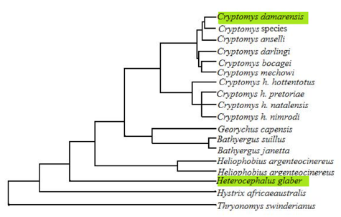
Kin selection via limited dispersal
Mole rat phylogeny
Eusocial species highlighted in green
Higher relatedness within a colony → shifts Hamilton’s rule
r*b > c

Slide 15
So many ways to cooperate!

Slide 16
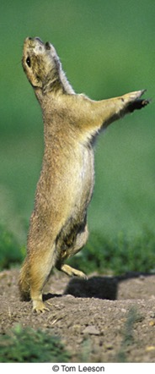
Belding’s Ground squirrels
Live in colonies.
Females live with kin
They are preyed upon by both aerial and terrestrial predators.
When a predator is nearby, females give loud, conspicuous alarm calls.
Paul Sherman
Sherman 1977, Science 197: 1246-1253

Slide 17
Belding’s Ground squirrels
Five hypotheses to explain alarm calling:
Females are helping kin (‘nepotism’)
Females are helping particular cooperative partners who will reciprocate later (I help you now, you help me later)
Females are helping the whole group
Alarm calls deter or confuse the predator
Alarm calls reduce the chance that the predator will attack again
Paul Sherman
Sherman 1977, Science 197: 1246-1253

Slide 18
Belding’s Ground squirrels
Females like this | Call more than | Females like this
Reproductive (lactating or living with weaned pups) | >> | Non-reproductive (no living pups)
Reproductive and have living adult female relatives | >> | Reproductive but have no living adult female relatives
Reproductive and are long-term colony residents | >> | Reproductive but just moved in and don’t stay long
Reproductive and have relatives above ground when the predator appears | >> | Reproductive, but relatives are below ground when the predator appears
Paul Sherman
Sherman 1977, Science 197: 1246-1253

Slide 19
Belding’s Ground squirrels
Five hypotheses to explain alarm calling:
Females are helping kin (‘nepotism’)
Females are helping particular cooperative partners who will reciprocate later (I help you now, you help me later)
Females are helping the whole group
Alarm calls deter or confuse the predator
Alarm calls reduce the chance that the predator will attack again
Paul Sherman
Sherman 1977, Science 197: 1246-1253

Slide 20
So many ways to cooperate!

Slide 21
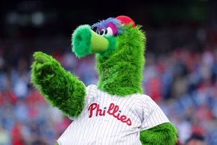
Green beard effect
“I have a green beard and I will be altruistic to anyone else with a green beard”
Richard Dawkins, The Selfish Gene 1976
Occurs when one genetic variant (allele) does three things:
A perceptible trait (green beard)
That green beard can be recognized by others
Preferential treatment of those with the green beard

Slide 22
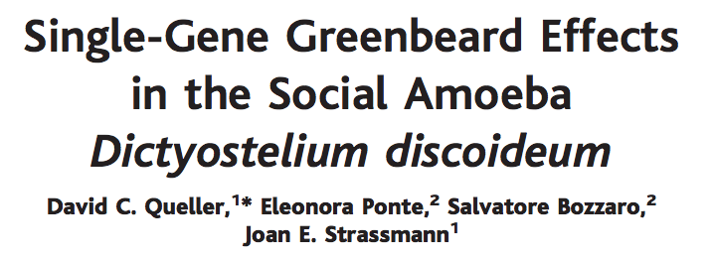
Green beard effect: Slime molds!
Solitary: forage for bacteria in soil
Social: when food scarce, aggregate by thousands to make fruiting body: stalk with spores at end
20% of cells are in stalk; don’t get to reproduce
csA gene: encodes cell adhesion protein in membrane → so cells can bind together
If you knock out the csA gene, they can’t bind to each other to make fruiting body
Only saw this effect when growing cells in soil
In the lab conditions, csA knock-outs weren’t able to be in stalk, so ended up as spores!

Slide 23
So many ways to cooperate!

Slide 24
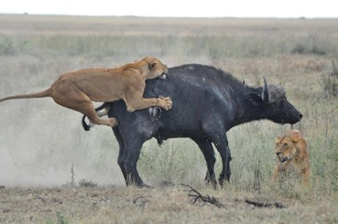
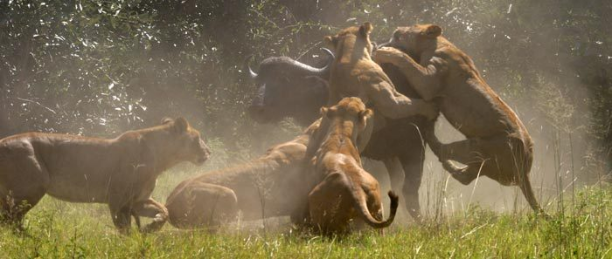
By-product benefits
Occurs when cooperation yields a ‘by-product benefit’ that outweighs the cost of cooperation
And also outweighs the benefits of cheating (i.e., of taking the fruits of others’ cooperative behavior).
Buffalo are generally too big for single lions to take down
Buffalo can be taken down by groups of lions

Slide 25
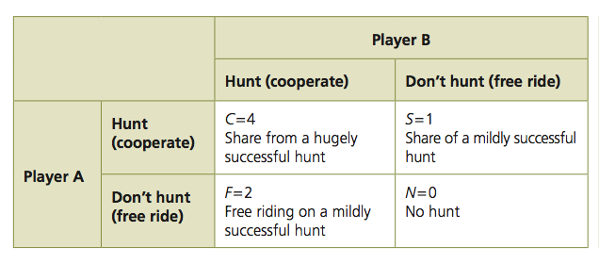
Evolution of cooperation via by-product benefits
Can be modeled in a game theory framework
Payoff to
Player A:
Here, cooperation yields a ‘by-product benefit’ that outweighs the cost and also outweighs the benefit of ‘free-riding’.

Slide 26
Evolution of cooperation via by-product benefits
But how often do payoff matrices in nature look like this?
Perhaps not that often. Free-riding can be easy.
Many known examples of cases where individuals can benefit from free-riding or cheating:
Lion prides and wolf packs during hunting (Heinsohn & Packer 1995, Science; MacNulty et al. 2012, Behavioral Ecology)
Territorial defense in ring-tailed lemurs (Nunn & Deaner 2004, Behav Ecol Sociobiol 57: 50-61)
Tax-paying in human societies (Ibuka et al. 2014, PLoS One 9:e87164).
How does cooperation evolve when free-riding pays off?

Slide 27
So many ways to cooperate!

Slide 28
So many ways to cooperate!
Ways to enforce cooperation:
Punish defectors
Impose direct physical cost on defectors

Slide 29
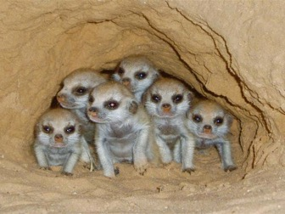
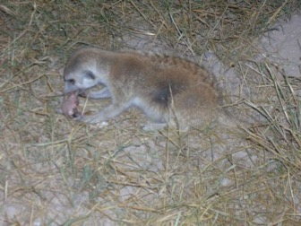
Enforcement via punishment in meerkats
Dominant female reproduces
If subordinate female becomes pregnant:
Dominant female attacks and evicts. Extremely stressful, likely reduces survival
If subordinate evades eviction:
Dominant female kills infant

Slide 30
So many ways to cooperate!
Ways to enforce cooperation:
Punish defectors
Impose direct physical cost on defectors
Sanction defectors
Shun defectors

Slide 31
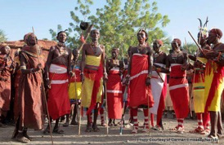
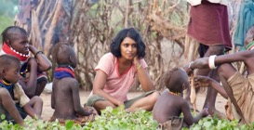
Enforcement via sanctions and punishment in humans
Turkana: nomadic pastoralists, no strong political system
Raids on other groups fairly common way to gain resources
Hundreds participate in raids; non-relatives
Raiding has substantial benefits to participants
Average gain is 11 cattle per participant in ‘force’ raid
Raiding poses substantial cost to participants
From puberty to end of reproduction, 60% of mortality due to warfare
1.1% chance of being killed in each ‘force’ raid
Free-riding common
Desertions occurred in 43% of raids
Cowardice occurred in 45% of raids
Taking more than your fair share occurred in 56% of raids
But free-riders are sanctioned and punished
Deserters and cowards sanctioned (ostracized) if free-loading minor
Corporal punishment and donation of an animal if free-loading extreme
Mathew & Boyd 2011 PNAS

Slide 32
So many ways to cooperate!
Ways to enforce cooperation:
Punish defectors
Impose direct physical cost on defectors
Sanction defectors
Shun defectors
Policing
Take action against defectors based on rules

Slide 33
Enforcement via policing in wasps, ants & bees
The European hornet,
Vespa crabro
In many species of bees, wasps, and ants, workers can lay eggs, but these eggs are often killed by the queen or other workers.
Workers are coerced to forgo reproduction
This behavior constitutes ‘policing’ of enforcing cooperation
In species that are especially good at policing, fewer workers reproduce
The higher the relatedness among workers, the more workers lay eggs (ie, policing less effective/present)
Interpretation: as opportunity for kin selection increases, policing less necessary
”Better law enforcement can lead to fewer individuals behaving antisocially”
Weenseleers & Ratnieks, 2006, Nature

Slide 34
So many ways to cooperate!
Ways to enforce cooperation:
Punish defectors
Impose direct physical cost on defectors
Sanction defectors
Shun defectors
Policing
Take action against defectors based on rules
Reward
Benefit to cooperators

Slide 35
So many ways to cooperate!
Ways to enforce cooperation:
Punish defectors
Impose direct physical cost on defectors
Sanction defectors
Shun defectors
Policing
Take action against defectors based on rules
Reward
Benefit to cooperators
Reciprocity
You scratch my back, I’ll scratch yours

Slide 36
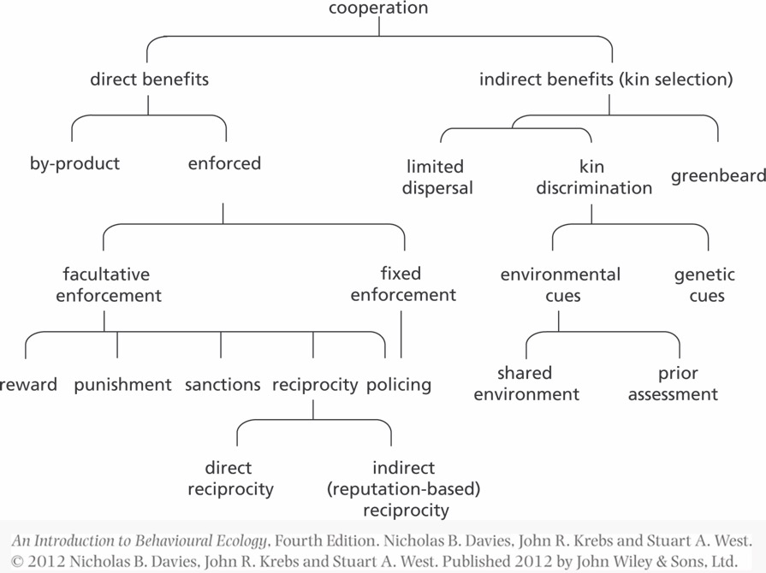
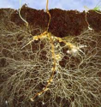
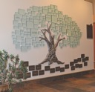
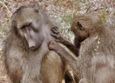

Slide 37
Simulation: The Evolution of Trust
https://ncase.me/trust/

Slide 38
Case study: Cooperation in vampire bats

Slide 39
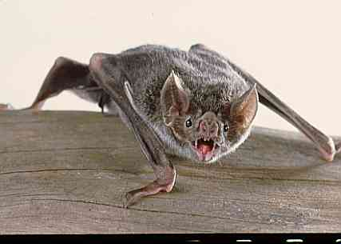
Vampire bat social structure
Females live in colonies of 8-12 with some kin and some unrelated individuals
Relatedness in colony ~ .1
Feed on blood; need to eat half of their body weight every night!
~30% of nights, an animal fails to get enough food
Bats will regurgitate to group-mates who missed a meal

Slide 40
Hypotheses…
Cost to donor is smaller than the benefit to the recipient (r*b > c)
Bats either prefer kin, give reciprocally, or enforce cooperation in some way (eg, policing)
Notes:
Cost to donor is smaller than the benefit to the recipient (r*b > c)
Bats either prefer kin, give reciprocally, or enforce reciprocity in some way (policing?)

Slide 41
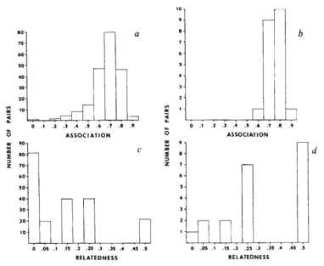
The Data
Bats regurgitated preferentially to relatives and close associates.
Watched a few colonies of bats for 400 hours
110 cases of regurgitation
77/110 was mother to nursing offspring
For 21 remaining regurgitations, they knew both (1) relatedness and (2) how much time the pair spend with each other
Colony description →
← Who regurgitated to whom
Wilkinson 1984, Nature

Slide 42
The Data
Females can live really long – up to 18 years!
Annual mortality is low (24%), so females spend many years roosting together
Of 9 females observed together in year, 7 were still together two years later
Bats interact with each other iteratively
Wilkinson 1984, Nature

Slide 43
The Data
Caught 8 bats at dusk and didn’t feed them; returned to roost at dawn
5/8 were fed by group member
Caught 6 bats at dusk after they fed; returned to roost at dawn
0/6 were fed
Bats don’t waste their blood meals on full friends, so there’s some cost to regurgitating
Wilkinson 1984, Nature

Slide 44
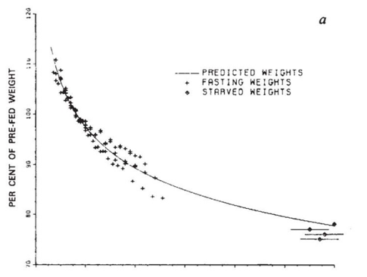
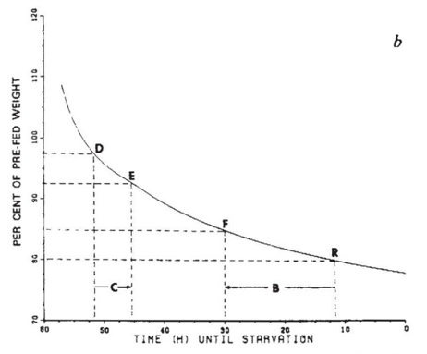
The Data
The cost of giving a bloodmeal is smaller than the benefit of receiving one
(b > c)
Giving a blood meal DOES pose a cost!
Weight decreases exponentially following a meal
Time (h)
Wilkinson 1984, Nature

Slide 45
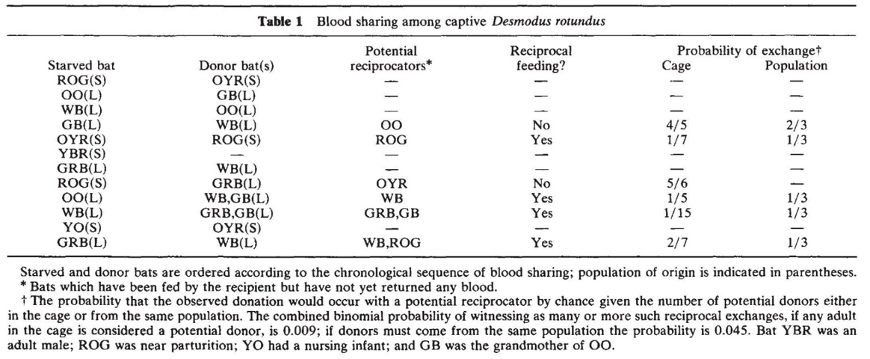
The Data
Bats reliably regurgitate to prior donors
Wilkinson 1984, Nature
Created a new roost from two prior populations of roost-mates
One was starved every night, on a rotating basis, to observe who regurgitated
Notes:
12/13 donations were pairs from the same original group, and they reciprocated way more than expected by chance
YBR is the only male. He didn’t get a donation.

Slide 46
How is cooperation maintained?
Bats regurgitated preferentially to relatives and close associates.
Bats interact with each other iteratively
Bats don’t waste their blood meals on full friends, so there’s some cost to regurgitating
The cost of giving a bloodmeal is smaller than the benefit of receiving one (b > c)
Bats reliably regurgitate to prior donors
Wilkinson 1984, Nature

