Slide 1
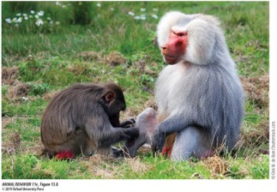
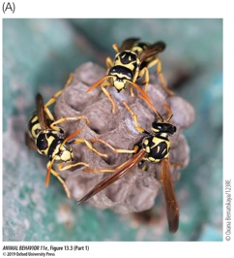
Social Behavior
Foundations of Animal Behavior
January 28, 2020
Emily Levy

Slide 2
Learning objectives
Understand and appreciate range of social behaviors in animal kingdom
Understand the function of social behavior
Understand ecological factors that can facilitate the evolution of social behavior
Discuss studies of social behavior in diverse species to focus on key aspects and differences across species/studies

Slide 3
Outline
Whirlwind tour of social behavior (5:30-6:00)
Function of social behavior
Ecology & evolution of social behavior (6:00-6:15)
Literature jigsaw: commonalities and differences (marmots, spiders, baboons, humans) (6:15-6:45)
Feedback (6:45-7:00)

Slide 4
Whirlwind Tour of Social behavior

Slide 5
https://www.youtube.com/watch?v=bzfqPQm-ThU

Slide 6
Categories of social structures
Aggregations
Semi-stable groups
Permanent groups

Slide 7
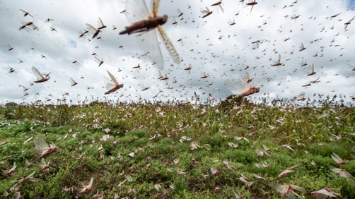
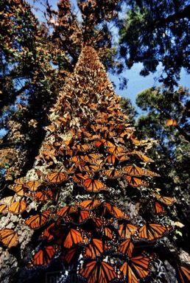
Structures: Aggregations
Transient
No obvious social structure
Group membership not permanent
Note: we might be calling something an aggregation because we haven’t studied it enough!

Slide 8
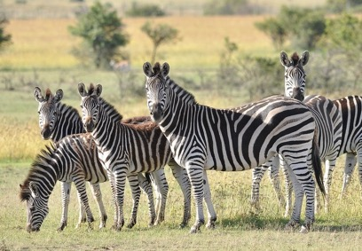
Structures: Semi-stable groups
Fission-fusion (group membership fluctuates)
Varying amounts of social structure
https://www.youtube.com/watch?v=V4f_1_r80RY

Slide 9
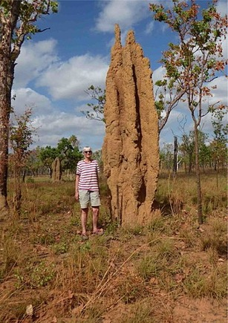
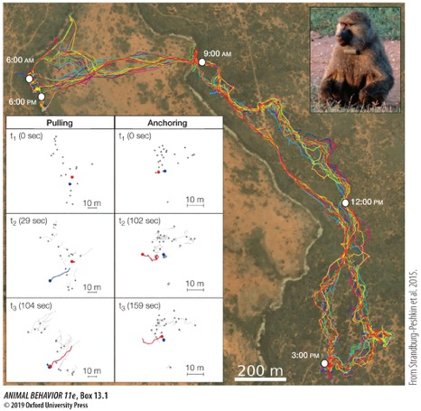
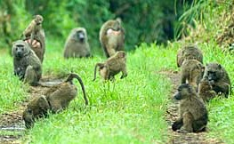
Structures: Permanent groups
Often high degree of social structure

Slide 10
Categories of social behavior

Slide 11
Behaviors: Mutual benefit
Behavior increases fitness in both parties
Paper wasp: Females cooperate to found a nest in spring
Only one queen (who reproduces)
So why cooperate if you’re not the queen?
If queen dies, a subordinate can become queen – and have even higher reproductive rate than the founder queen did (Leadbeater et al 2011)

Slide 12
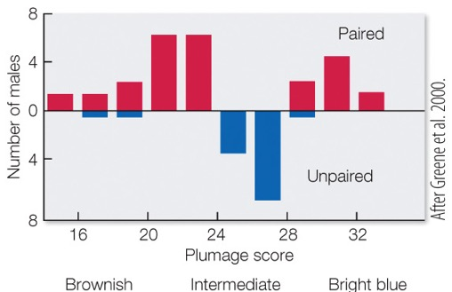
Behaviors: Mutual benefit
Behavior increases fitness in both parties
In lazuli buntings, brightly-colored males allow especially dull males to nest adjacent to their territory
Benefit to bright male: Some of their eggs end up in dull male’s nest
Benefit to dull male: a non-zero chance of mating (Greene et al 2000)

Slide 13
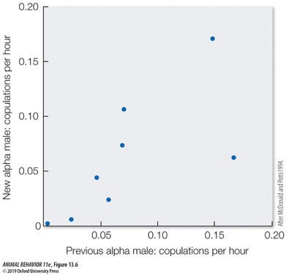
Behaviors: Mutual benefit
Behavior increases fitness in both parties
In long-tailed manakins, two males cooperate to perform a mating dance
Benefit to alpha male: mates with the female
Benefit to beta male: They’re next in the queue if the alpha disappears (McDonald & Potts 1994)
In other manakin species, betas may be learning the dance
https://www.youtube.com/watch?v=6V9FZSDmR1U

Slide 14
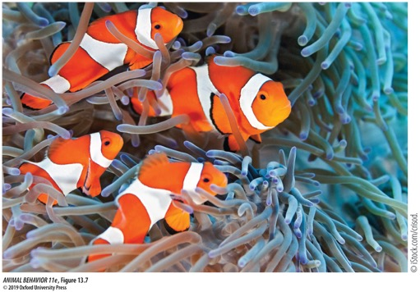
Behaviors: Mutual benefit
Behavior increases fitness in both parties
In clownfish, individuals in groups have specific roles:
Female: biggest
Breeding male: second-biggest
Subordinate males: smaller
When female dies:
Breeding male changes sex and becomes breeding female
Subordinate male grows and becomes breeding male
Notes:
Breeding males tolerate subordinates because it’s no cost with them around, and costly to chase them away

Slide 15
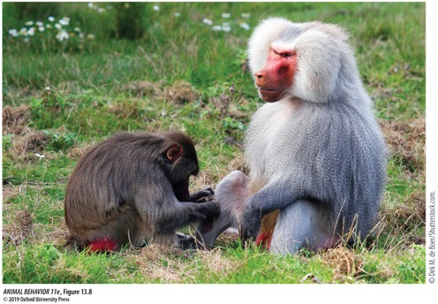
Behaviors: Altruism
Note: ‘real’ altruism is a mistake
Two non-altruism categories that we often call altruism:
With kin
When benefit to the altruist is delayed or indirect (reciprocity)
E.g., baboons grooming
We will discuss more next week!

Slide 16
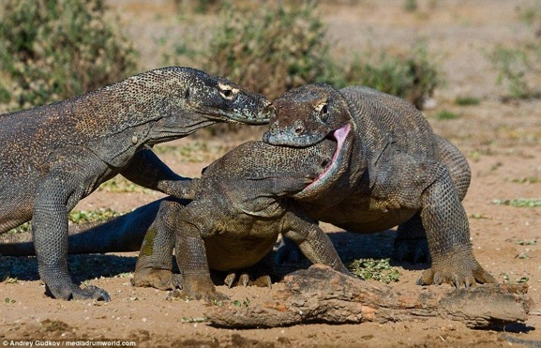
Behaviors: Selfishness & Spite
Selfishness: Stealing food or other resources via coercion
Spite: Very rare in nature!
Why?

Slide 17
Key take-aways
Social behavior is common across the animal kingdom
Social behavior is incredibly diverse, both in form and function
Thinking in terms of costs and benefits can help us frame the adaptive benefit of behaviors

Slide 18
What’s the function of social behavior?

Slide 19
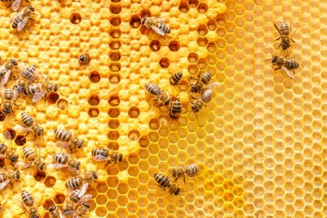
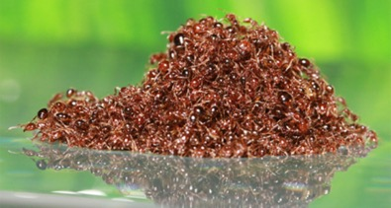
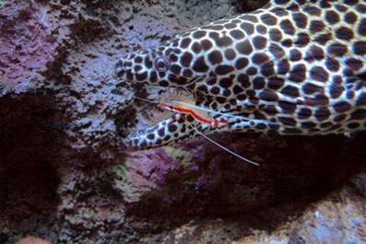
Why be social?
Function of behavior:
Enables you to use your environment to gain benefits
Other individuals are part of your environment → social environment
Being social allows you to use other individuals to gain benefits
Particularly exciting because your environment can behave right back at you

Slide 20
Ecology and evolution of social behavior
Notes:
6:00-6:15

Slide 21
Forming groups: The selfish herd (Hamilton 1971)

Slide 22
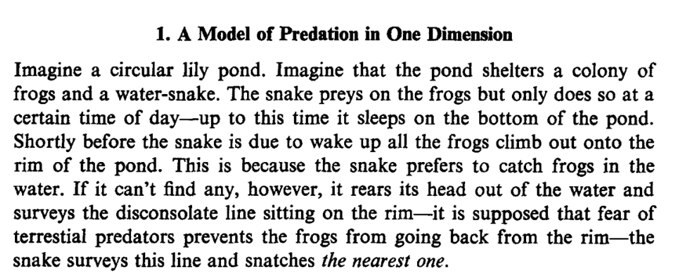
Forming groups: The selfish herd (Hamilton 1971)

Slide 23
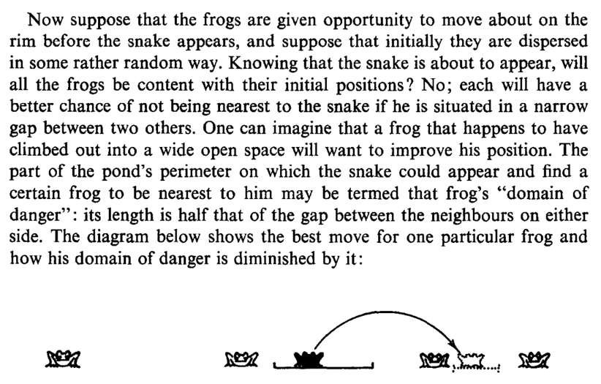
Forming groups: The selfish herd (Hamilton 1971)

Slide 24
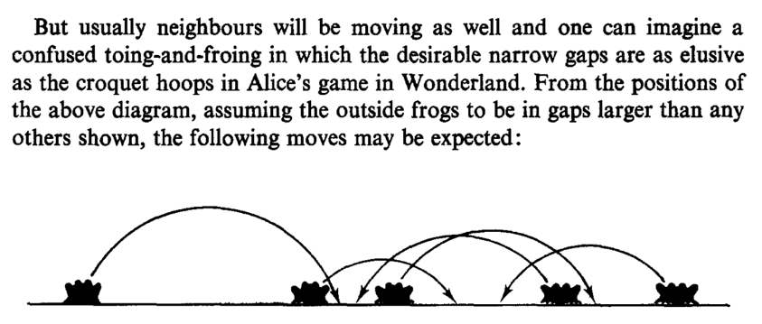
Forming groups: The selfish herd (Hamilton 1971)

Slide 25
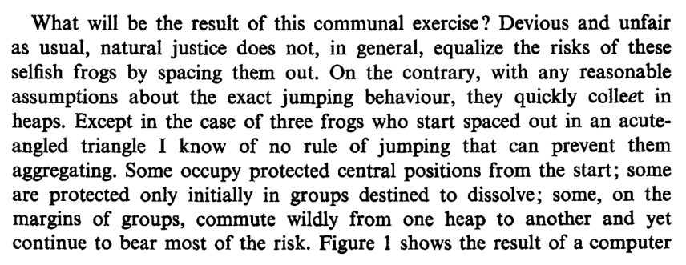
Forming groups: The selfish herd (Hamilton 1971)

Slide 26
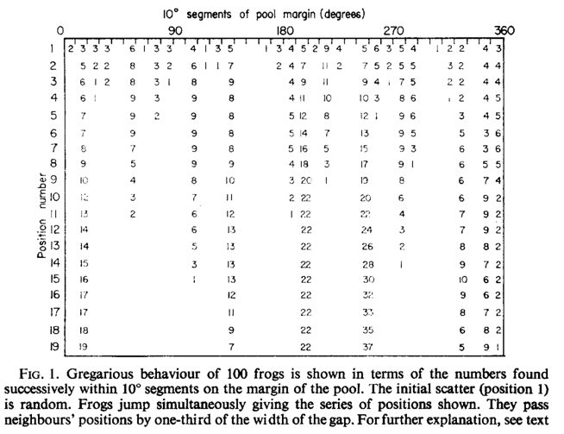
Forming groups: The selfish herd (Hamilton 1971)

Slide 27
Forming groups: The selfish herd (Hamilton 1971)

Slide 28
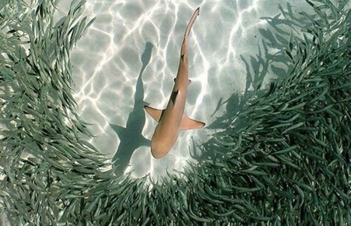
Costs and benefits (to the individual) of group living
Benefits
Predation: Dilution

Slide 29
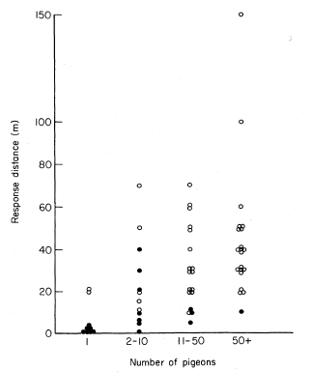
Costs and benefits (to the individual) of group living
Benefits
Predation: Dilution
Predation: Detection & Defense

Slide 30
Costs and benefits (to the individual) of group living
Benefits
Predation: Dilution
Predation: Detection & Defense
More efficient foraging
Hunt together
Find food faster and reduce risk of arriving at already-scavenged food source?
Can monopolize food sources

Slide 31
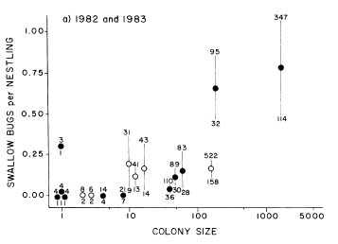
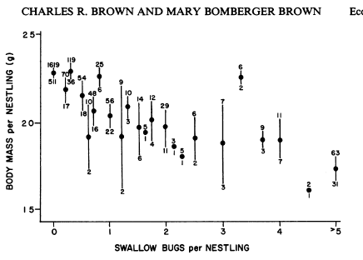
Costs and benefits (to the individual) of group living
Benefits
Costs
Predation: Dilution
Predation: Detection & Defense
More efficient foraging
Easier disease and parasite transmission
Alexander hypothesizes close quarters facilitate resistance

Slide 32
Costs and benefits (to the individual) of group living
Benefits
Costs
Predation: Dilution
Predation: Detection & Defense
More efficient foraging
Easier disease and parasite transmission
Alexander hypothesizes close quarters facilitate resistance
Competing for food access with your group members
We just used ecological concepts to think about how behavior can be selected for and evolve!

Slide 33
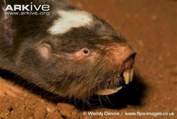
Ecology and evolution of mole rats: A comparative analysis (Faulkes et al 1997; Jarvis et al 1994)
African mole-rats: some species solitary, some social, and…
Two species are eusocial: naked mole-rat and Damaraland mole-rat
Eusociality evolved two times! – convergent evolution
Among social species, 3 ecological factors predicted the species’ group size
Food density (larger groups w/ less food density)
How much rain (larger groups w/ less rain)
How much variation in rain (larger groups w/ more variation) -- predictability
‘Food-aridity’ Hypothesis:
Ecological conditions determine social structure.
Hard to disperse when arid and food is scarce; cooperation may also be especially beneficial

Slide 34
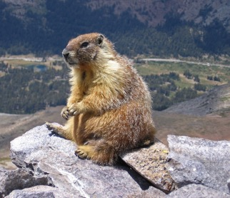
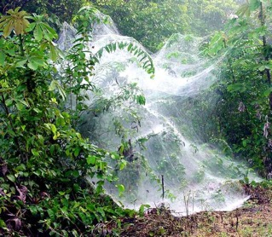
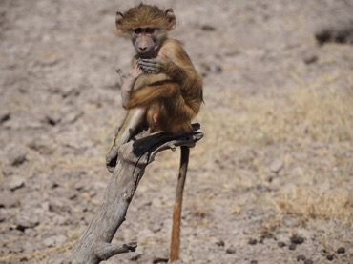
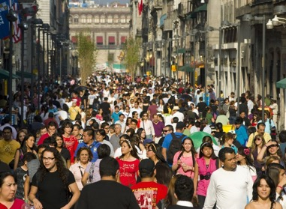
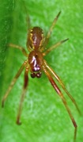
Literature jigsaw
Notes:
6:15-6:45

Slide 35
Feedback please!
Notes:
6:45-7

