Slide 1
The Adaptationist Programme

Slide 2
Adaptations
Adaptations are…
Traits that have evolved via natural selection
Traits that facilitate an organism’s ability to thrive in its environment
Adaptations are not…
Traits that change over time due to habituation

Slide 3
The adaptationist programme
Adaptationist programme
Organisms are made up of lots of independent traits; each trait is a product of natural selection
If that fails: trade-offs between optimizing connected traits
“Any suboptimality of a part is explained as its contribution to the best possible design for the whole”
“When one adaptive argument fails, try another…[or] assume another must exist…[or] attribute failure to imperfect understanding of where an organism lives and what it does”

Slide 4
The adaptationist programme
Do you tend to engage in adaptationist thinking?
Any bit of text that struck you?
What’s a healthy level of skepticism?

Slide 5
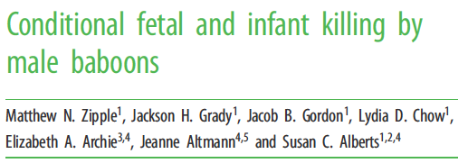
Infanticide & feticide

Slide 6
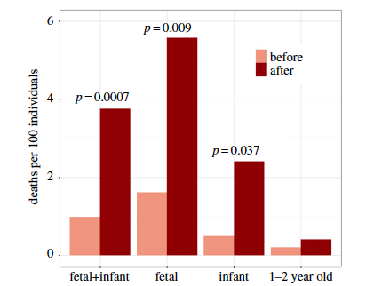
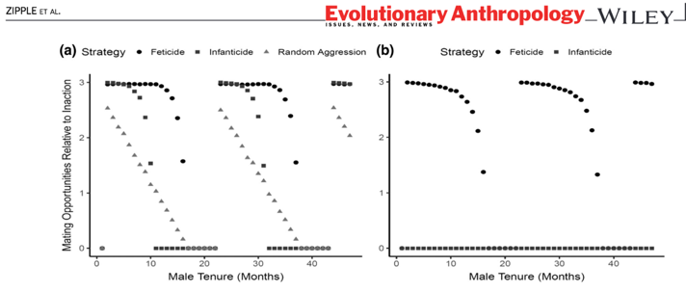
Infanticide & feticide
How is infanticide be adaptive? And for who?
How is feticide adaptive? For who?
Notes:
FIGURE 2(a) Averaged across all group sizes, feticide yields equal or greater reproductive benefits than inaction, random aggression, orinfanticide in 96.1% of simulations. Reproductive benefits attained by each strategy are cyclical with a period matching the 21-month interbirthinterval in the simulation. (b) When females display postpartum estrus, males gain no benefit from infanticide but still benefit from feticide

Slide 7
Evolutionary thinking: Conclusions
Evolutionary timelines can be long, short, or anywhere in-between
‘The Ecological Theater and the Evolutionary Play’ (Hutchinson 1965)
Under natural selection, genes are ‘selfish’ (Dawkins 1976)
Genes in more ‘fit’ individuals will produce more copies than genes in less ‘fit’ individuals
There is no master plan or optimization
But it’s really easy to fall into that way of thinking

Slide 8
Genes to behavior (and everything in-between)

Slide 9
What do genes do? (What is the role of genes in producing the phenotype?)
Genes are rule-governed machines:
In the presence of environment x, produce protein y in specific places at specific times.
Genes are not a blueprint or a master design.
“Genes are passive sources of materials upon which a cell can draw…for metabolism, growth and differentiation.”
Nijhout 1990, BioEssays 12:441-446
Notes:
Stop thinking about genes as blueprints for organisms and consider them as suppliers of raw material responding to instructions.

Slide 10
Why do we want to genetically map traits (including behavioral traits)?
Help us understand the physiology or proximate mechanisms behind a trait.
Are multiple genetic changes contributing to the phenotype and if so how?
How many physiological processes might be involved or affected?
Provide insight into how complex traits evolve
Through many genetic changes of small effect or a few changes of large effect?
Through changes in coding regions or changes in regulatory regions?
Do similar traits in similar species evolve in the same way?

Slide 11
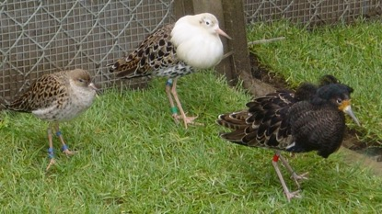
Mendelian genetics: Ruffs
3 male mating strategies:
Independents – showy displays
Satellites – on the sidelines
Faeders – mimic females
Differences in behavior, plumage, and body size
Cause: one big ‘supergene’ (125 genes)
3 alleles: original, modified1, modified2
2 copies of original ‘allele’ → Independent
1 copy original, 1 copy modified1 → Faeders
1 copy original, 1 copy modified2 → Satellite
2 copies of modified → Lethal
Küpper et al 2015; Lamichhaney et al 2015

Slide 12
Mendelian genetics: Ruffs
Küpper et al 2015

Slide 13
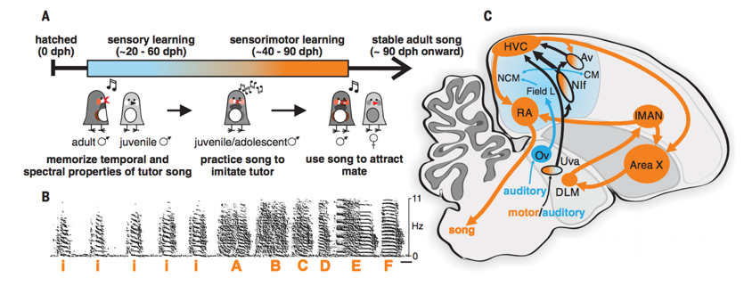
Neurons -> Behavior
Relatively good understanding of brain regions involved in zebra finch bird song
Brain regions involved in song learning and production
Learn from a tutor
Song spectrogram
Zhao, Garcia-Oscos, Dinh & Roberts 2019

Slide 14
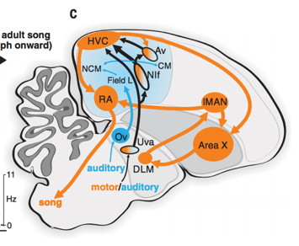
Neurons -> Behavior
Relatively good understanding of brain regions involved in zebra finch bird song. Two key players:
HVC: premotor region required for song production and involved in learning song
NIf: largest source of auditory input to HVC.
Neurons very active at beginning and end of song elements
Hypothesis: NIf activity codes the rhythmic aspect of song
Prediction: If we manually “turn on” and “turn off” neurons in NIf, we can we train birds to sing
Method: Optogenetics!
Zhao, Garcia-Oscos, Dinh & Roberts 2019

Slide 15
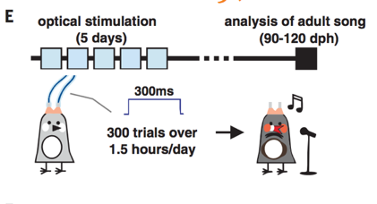
Neurons -> Behavior
What do you think birds will do?
Zhao, Garcia-Oscos, Dinh & Roberts 2019
Notes:
Chanelrhodopsins were discovered in algae! They help algae respond to light (phototaxis).
They allow ions in and out, which sets off an action potential
A win for basic research!

Slide 16
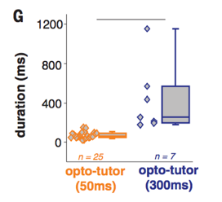
Neurons -> Behavior
Zhao, Garcia-Oscos, Dinh & Roberts 2019

Slide 17
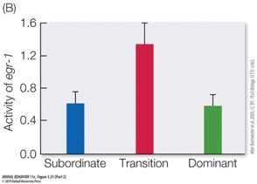
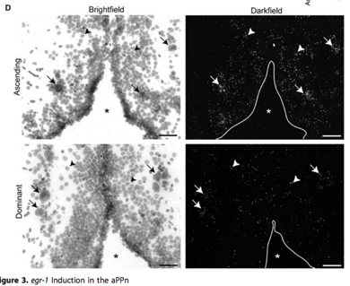
Genes -> Neurons -> Hormones -> Behavior
Cichlid fish Astatotilapia burtoni
Males either dominant (have mating grounds) or subordinate
When a dominant male is taken away, subordinate male undergoes rapid changes:
Specific nerve cells increase expression of early growth response protein 1 gene (egr-1).
Egr-1 codes for gonadotropin-releasing hormone
Gonadotropin-releasing hormone regulates reproduction by activating other genes and facilitating the production of other hormones
Within 1 week:
Neurons that make gonadotropin-releasing hormone larger
Testes larger
Behavior switch
Burmeister et al 2005

Slide 18
Putting it all together: Maternal density and offspring growth & hormones
Dantzer et al (2013) Density triggers maternal hormones that increase adaptive offspring growth in a wild mammal. Science, Vol 30

Slide 19
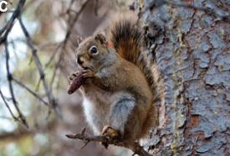
1. Background
When there’s more food, squirrel density is higher
When squirrel density is high, faster-growing offspring survive better through the winter
Density-dependent selection
When squirrel density is low, how fast you grow doesn’t matter for survival

Slide 20
2. Hypothesis & Prediction
What’s Dantzer et al’s question?
“Cues of population density in red squirrels might induce adaptive increases in offspring growth when density is high”
What’s the hypothesis?
“We hypothesized that territorial vocalizations provide a cue of density that allows females to adaptively adjust offspring growth in anticipation of the density-dependent selection that they will experience”
Predictions:
If territorial vocalizations provide a cue of density, then exposing females to vocalizations will induce the females to act as if density is high
Females in high density condition will have pups that grow faster
They already established that growing faster under high density is adaptive
There is some hormonal mechanism that allows moms to induce a faster growth rate – perhaps glucocorticoids!

Slide 21
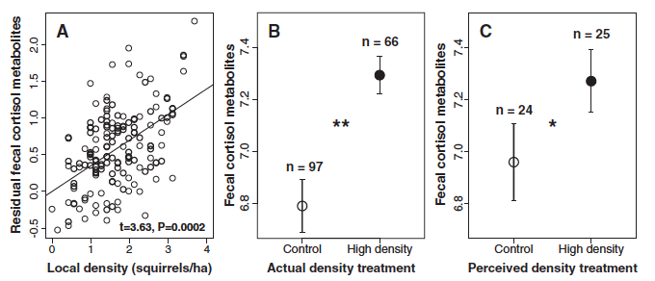
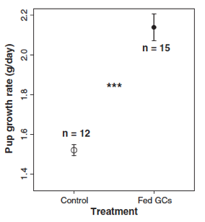
3. Findings: a trifecta
Females in higher perceived or actual density had offspring that grew faster than females in low density
Females in higher perceived or actual density had higher GCs than females in low density
Females fed GCs had pups who grew faster than females who weren’t fed GCs

Slide 22
Take-aways
Studying mechanisms of animal behavior from ‘start to finish’ is hard! And…
Studying those mechanisms in a wild animal is even harder ! And…
Studying evolution AND mechanisms of wild animal behavior is even harder.
We have natural selection to thank for many (if not most) of the amazing diversity of animal behaviors we see outside (and in us)
There’s a huge diversity of pathways that allow behavior to occur –genes, neurons, morphology, environmental cues, muscles, etc

Slide 23
https://www.youtube.com/watch?v=YH1ytkBM69Q

Slide 24
Next week: Social behavior
Assign readings

