Slide 1
Evolution & Mechanisms of Animal Behavior
Week 2
Foundations of Animal Behavior
Emily Levy
Some slides adapted from Susan Alberts

Slide 2
Outline
Evolution & Natural Selection: Mechanisms
Evolution & Natural Selection: Evolutionary thinking
Discussion: the Adaptationist programme
Case study: Infanticide & feticide in baboons
Mechanisms of animal behavior
Putting it all together: Maternal density and offspring growth & hormones

Slide 3
Outcomes
Understand how natural selection works
Understand evolutionary thinking and articulate evolutionary theories about behavior (ie, how natural selection can shape behavior)
Be able to explain why not all behaviors evolved via natural selection (adaptationist programme)
Understand, on a basic level, the mechanisms that can drive behaviors
Give some examples
Generate a hypothesis about underlying mechanisms

Slide 4
https://www.youtube.com/watch?v=PQbScg3r1oQ

Slide 5
Why do we need evolution to study animal behavior?
‘Nothing in biology makes sense except in the light of evolution’
Dobzhansky, 1973
Notes:
Evolution helps us figure out why animals do the things they do –
Why a bee will sting you if you come too close to its nest, even though it dies.
Why your dog is so bonded to you but looks wild when chasing a squirrel
Why and how flounders change color

Slide 6
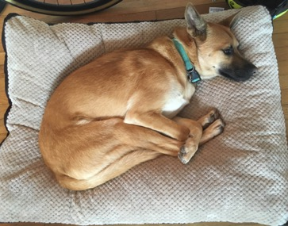
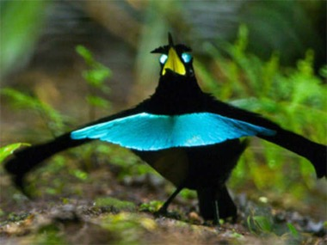
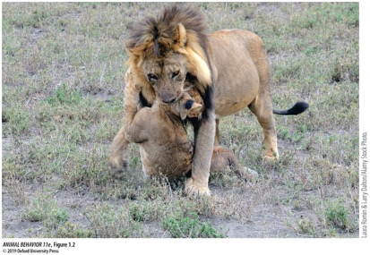
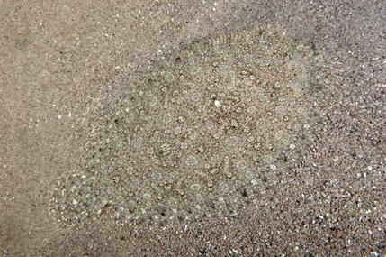
Why do we need evolution to study animal behavior?
‘Nothing in biology animal behavior makes sense except in the light of evolution’
Dobzhansky, 1973
Notes:
Evolution helps us figure out why animals do the things they do –
Why a bee will sting you if you come too close to its nest, even though it dies.
Why your dog is so bonded to you but looks wild when chasing a squirrel
Why and how flounders change color

Slide 7
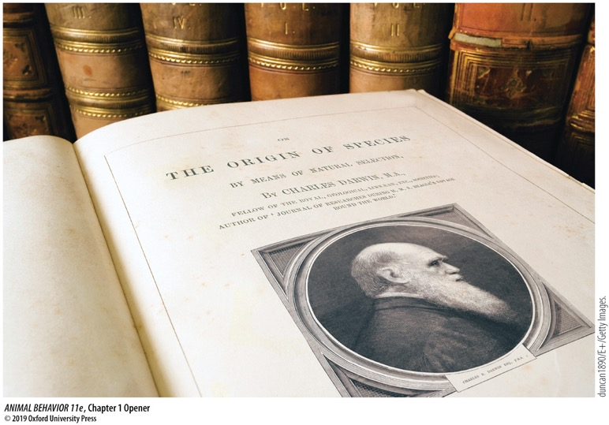
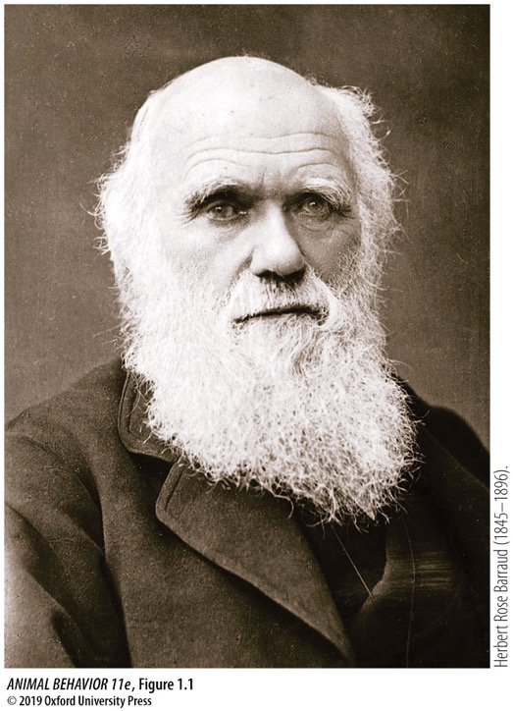
Evolution & Natural Selection: Mechanisms
How does natural selection actually happen, and how do behaviors evolve?
Notes:
He started the Origin with artificial selection – something accessible, as humans have been artificially selecting our pets and food for 10,000 years.

Slide 8
What is evolution?
Evolution = changes in allele frequencies
Phenotype = observable trait
Notes:
There are several mechanisms that can drive evolution (drift, migration) but we’lre focusing here on natural selection.

Slide 9
4 main mechanisms of evolution
Mutation
Random mistake in DNA (often during replication)
Can change offspring’s traits (color, behavior)
Migration (gene flow)
Movement of individuals to places where the genetic makeup is different
Genetic drift
Chance or random events that change allele frequencies
Matter most in small populations
Natural selection
Coming up…
Evolution.Berkeley.edu

Slide 10
Natural selection: 3 requirements
Variation
Members of the population differ in some trait
Drivers: genetic mutations, genetic recombination, migration
Differences in reproductive success (fitness consequences)
Some members reproduce more than others due to that trait
Heredity
The trait that alters reproductive success is heritable (passes on to offspring)
Not always genetic!
Notes:
Drivers of variation: Mutations (genetic), genetic recombination, migration
Heritibility: It is the proportion of all the variance in the trait that is due to genetic differences among individuals.

Slide 11
Natural selection: 3 requirements
Variation
Differences in reproductive success
Heredity
Natural selection is unguided and unconscious
No master plan
Organisms don’t will themselves to evolve

Slide 12
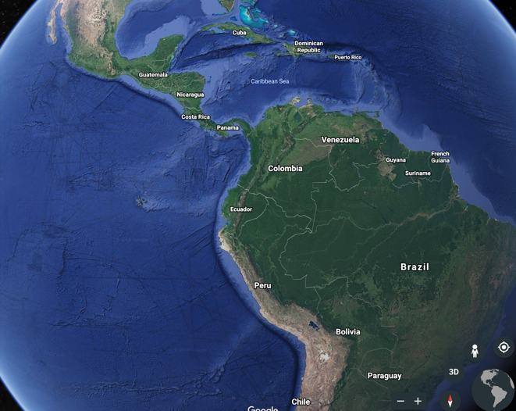
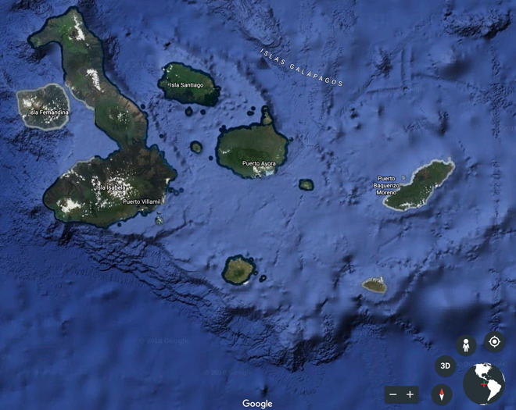
Natural selection is happening all the time, in real time
Darwin’s finches
The Galapagos Islands, Ecuador
The island of Daphne Major
Images courtesy of Google Earth

Slide 13
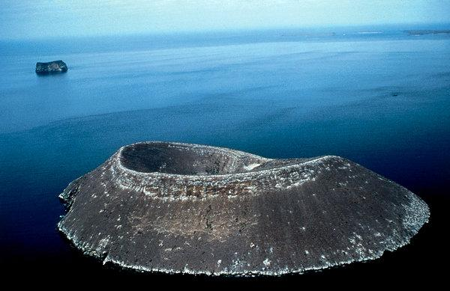
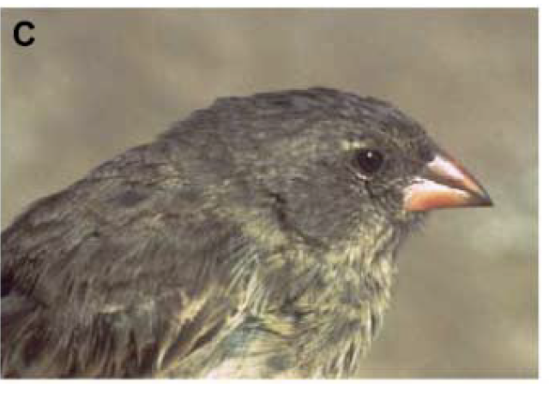
Natural selection is happening all around you in real time
The island of Daphne Major
The medium ground finch, Geospiza fortis

Slide 14
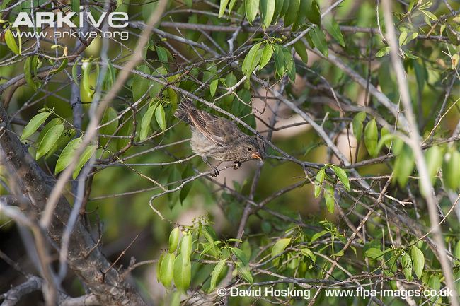
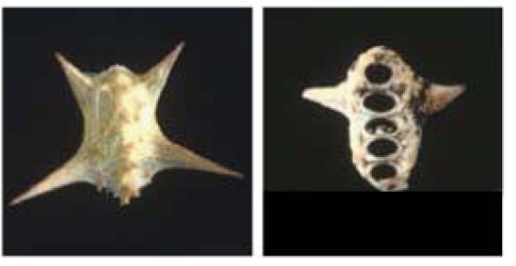
Natural selection is happening all around you in real time
But on Daphne Major, only cactus and cactus seeds are available to eat.
Small, softer seeds are most easily gathered by small beaks
Large, hard seeds require large heavy beaks to crack them open
On some of the islands, the habitat is not quite as arid

Slide 15
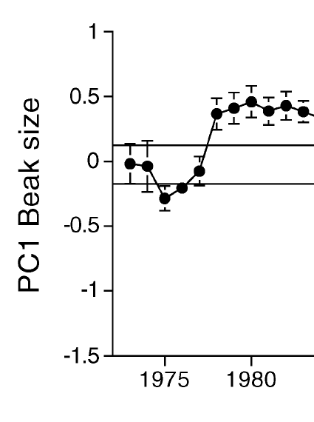
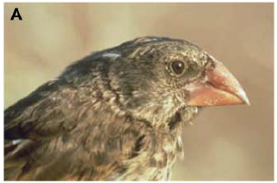
Natural selection is happening all around you in real time
In 1977, the islands are hit by a major drought.
Small seeds disappear. Only large, hard seeds are available to eat.
Consequences:
85% of birds die.
Larger-beaked birds survive better than smaller-beaked birds.
The tendency to be large-beaked is heritable.
Evolution occurred
Geospiza fortis, the medium ground finch
Small-beaked individual
Large-beaked individual
Boag and Grant, 1981, Science 214:82-85

Slide 16
Evolution & Natural Selection: Evolutionary Thinking
Ie, the bigger picture

