Slide 1
Darwin’s Behavior-Or-Not!

Slide 2
…is this behavior?
https://www.youtube.com/watch?v=mif85TXQTwE&feature=emb_title
Notes:
Flounder camouflage by changing the visibility of their chromatophores: cells that contain pigment
So they move those cells around, with different cells having different pigments, to blend in.
Cells are controlled by muscles

Slide 3
…is this behavior?
https://www.youtube.com/watch?v=1pJPnZFSy5o&t=4s

Slide 4
what about this?
Notes:
You see a lion stalking you. Your body undergoes a stress response.
Is that a behavior?
Then you run! Or fight!
Is that behavior?
What if, instead of a lion, I told you you had a pop quiz at the end of the class? Does that count as a stimulus, and does your stress response count as a ‘response’?

Slide 5
…and this?
https://www.youtube.com/watch?time_continue=8&v=DhITXtENPrU&feature=emb_title

Slide 6
…or this?
Notes:
Suzanne Simard’s research:
Trees send out signals to each other as wel as nutrients via fungal-root networks
Symbiotic fungi associated with all tree roots. Fungi provide nutrients from soil, and trees give fungi water and sugar.
These fungi also connect trees to each other
Communication is about how trees send warning signals about environmental conditions, look for kin, and transfer nutrients.
She found that douglas fir and birch share with each other – fir getting more carbon in summer when it was shaded, and birch getting more in winter when it didn’t have leaves.

Slide 7
even this?
Notes:
Peppered moths
In England, ‘original’ or most common phenotype was white with speckles, likely due to selection – they blended in well with lichen on trees
Industrialization in 1800s: coal → soot → lichen died and trunks darker in urban environments
First black moth spotted 1848
Black morph fared better
This happened fast! In a matter of years!

Slide 8
Outline
Welcome!
What is behavior?
Why do we care?
Brief basics
Methods of animal behavior research
Planet Earth

Slide 9
Why do we care?
Behavior = interacting with your environment
Physical surroundings
Food sources
Social surroundings
Predators
Behavior = interacting with your environment to gain benefits
Food
Water
Mates
Safety from predators
Social partners

Slide 10
Why do we care?
Animals can respond to changes in their environment via behavior
Behavior is plastic
Can change over time
Behavioral plasticity can happen fast
Training a dog
If you can behave plastically to a range of environments, you can survive.
Thought experiment: What would happen if a species was unable to move itself to the shade when it was hot?
Notes:
Behavior allows animals to live in a changing world without invoking evolution.

Slide 11
Outline
Welcome!
What is behavior?
Why do we care?
Brief basics
Methods of animal behavior research
Planet Earth

Slide 12
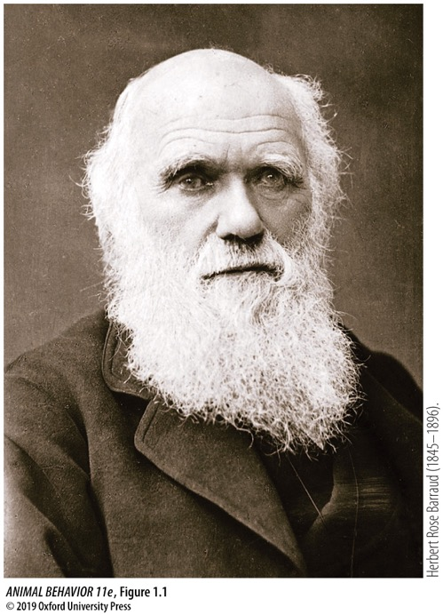
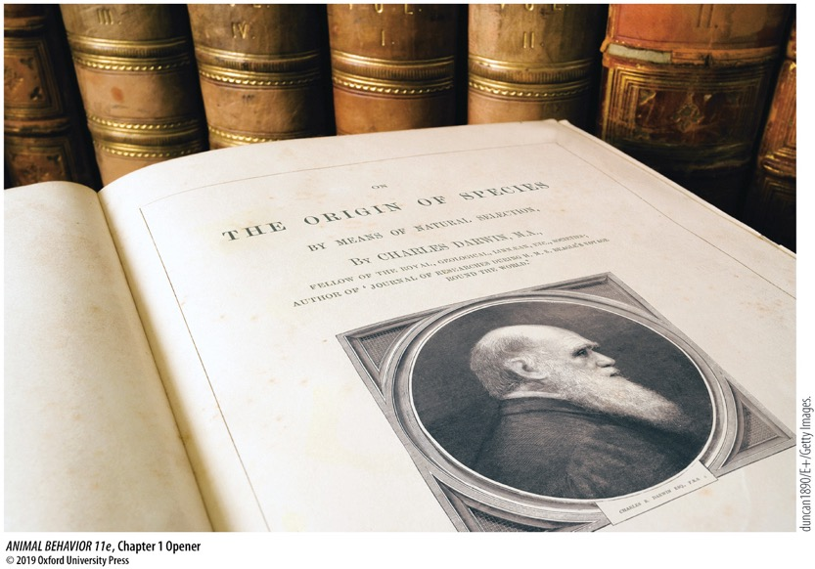
It all started with Darwin in 1859
Notes:
We’ll talk more about evolution next week!

Slide 13
Lorenz & Tinbergen
Konrad Lorenz (1903-1989) Niko Tinbergen (1907-1988)
Notes:
Karl von Frisch (honey bees, waggle dance) also co-founded
Tinbergen:
Dutch biologist working 1930—70s
Founded Ethology, came up with 4 questions
All three won nobel prize in 1973

Slide 14
Tinbergen & Lorenz
Hypothesis: The red dot acts as a cue to chicks →sign stimulus or releaser
Hypothesis: Chicks have an innate, instinctual response to that cue – peck at it!
→fixed action pattern
Notes:
Begging behavior by a herring gull chick.

Slide 15
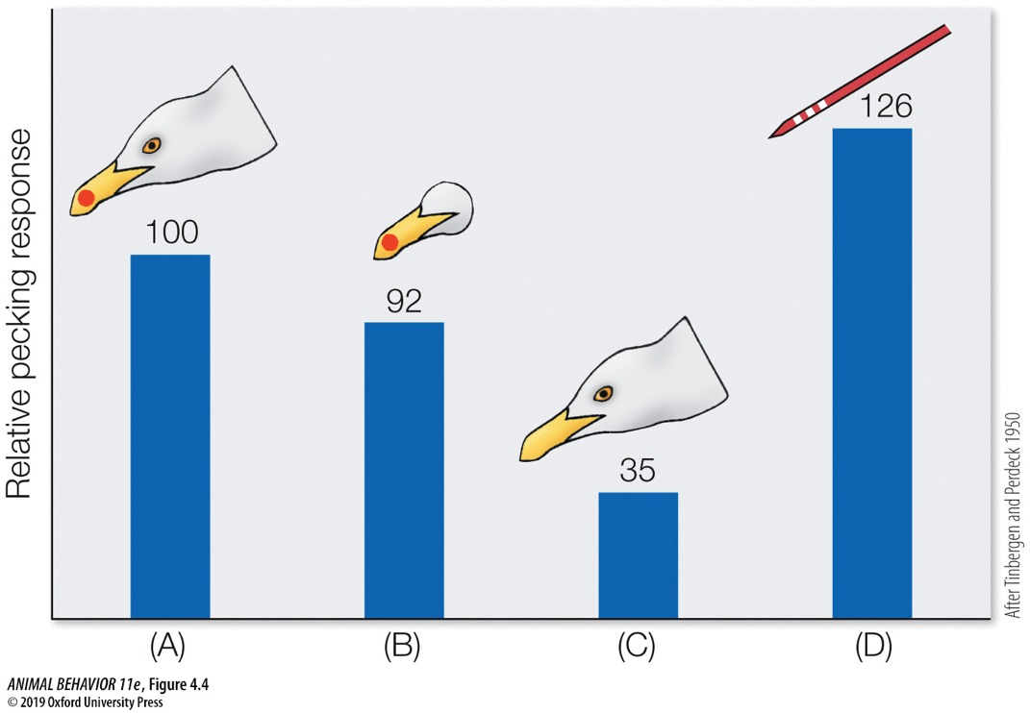
Tinbergen & Lorenz
Notes:
(After Tinbergen and Perdeck 1950.)

Slide 16
Tinbergen & Lorenz
Hypothesis: The red dot acts as a cue to chicks →sign stimulus or releaser

Slide 17
Tinbergen & Lorenz
Hypothesis: Chicks have an innate, instinctual response to that cue – peck at it!
→fixed action pattern
Notes:
Tinbergen also looked at instinctual behaviors such as a goose’s instinct to roll an egg-shaped thing back into the nest.

Slide 18
Levels of Analysis
Proximate
How?
Immediate & mechanistic
Ultimate
Why?
Adaptive value and evolutionary history
Notes:
Tinbergen developed these two general ways of studying behavior

Slide 19
Timing of Analysis
Contemporary
What’s happening now?
Single form
Chronicle
How did past lead to this?
Developmental/Historical
Notes:
And then split each into these other two ways

Slide 20
Tinbergen’s 4 Questions
 |  | Timing of Analysis
 |  | Contemporary | Chronicle
Level of Analysis | Proximate | Mechanism (causation) | Ontogeny (development)
 | Ultimate | Adaptive Value (function) | Phylogeny (evolution)

Slide 21
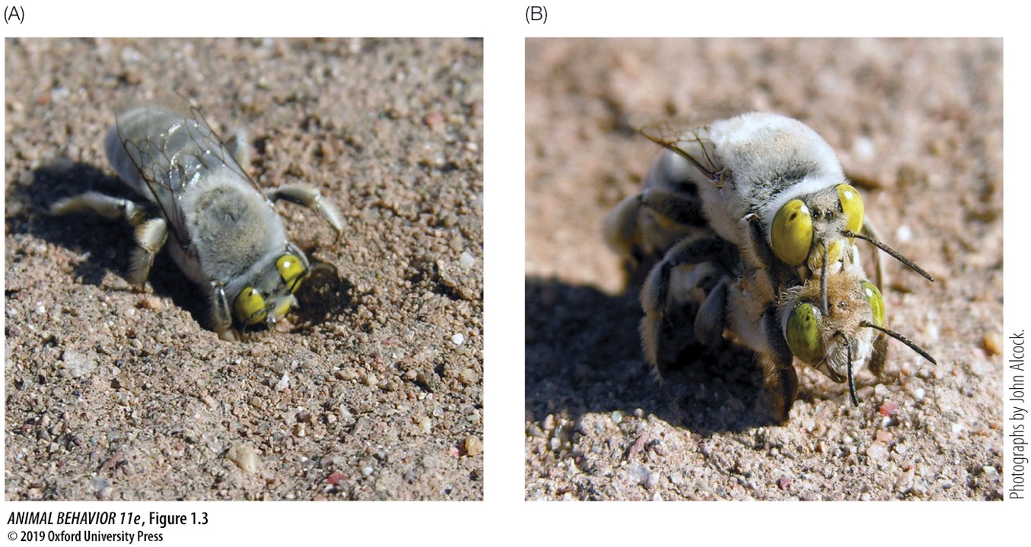
Tinbergen’s 4 Questions
Notes:
Digger bee (Centris pallida) in deserts of SW USA.
Life cycle: Females create underground chambers and lay eggs there. New females (and males) then develop underground, and wait for a male to dig them up and mate with them.
Males dig for females. Their ability to seek out females has been selected for.

Slide 22
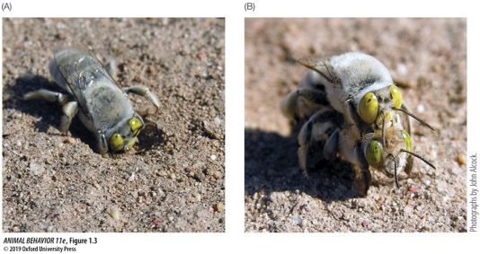
Tinbergen’s 4 Questions
 |  | Timing of Analysis
 |  | Contemporary | Chronicle
Level of Analysis | Proximate | Mechanism (causation) | Ontogeny (development)
 | Ultimate | Adaptive Value (function) | Phylogeny (evolution)
Do males smell females underground? genes, neurons, physiology
Does male age affects ability to sniff out females?
Do males with good ‘noses’ reproduce more than males without?
When did they diverge from non-digging bees?
Notes:
Digger bee (Centris pallida) in deserts of SW USA.
Life cycle: Females create underground chambers and lay eggs there. New females (and males) then develop underground, and wait for a male to dig them up and mate with them.
Males dig for females. Their ability to seek out females has been selected for.

Slide 23
Outline
Welcome!
What is behavior?
Why do we care?
Brief basics
Methods of animal behavior research
Planet Earth

Slide 24
How do you study animal behavior? 2 basics
We study what organisms do, not what they feel or intend
Public phenomena: observed & studied
Private phenomena: thoughts, feelings, intentions
Behaviors are evolved traits
Respond to selection like other traits, experience drift like other traits, changed by mutations like other traits

Slide 25
How do you study animal behavior? 3 Approaches
Observe
Link observed behaviors to environment, physiology, development, or phylogeny
Experiment
Allows us to imply causation
Compare
Look for patterns across species
Requires knowledge of evolutionary relationships among species

Slide 26
3 Approaches: Mobbing behavior in the black-headed gull
Notes:
Black-headed gulls (Chroicocephalus ridibundus) are colonial ground nesters in Europe and Asia.
Studied by Hans Kruuk in the 60s
Mobbing can be COSTLY! Energy, time, injuries, leaving the nest. But there can be BENEFITS! Increasing chance of offspring surviving

Slide 27
Hypothesis: Mobbing distracts potential predators from predating on nests
Prediction 1: Bird will only mob potential predators, not non-predators
Prediction 2: Predation will be higher when there is less mobbing
3 Approaches: Mobbing behavior in the black-headed gull
Notes:
Kruuk observed carrion crows, who predate on black-headed gull eggs

Slide 28
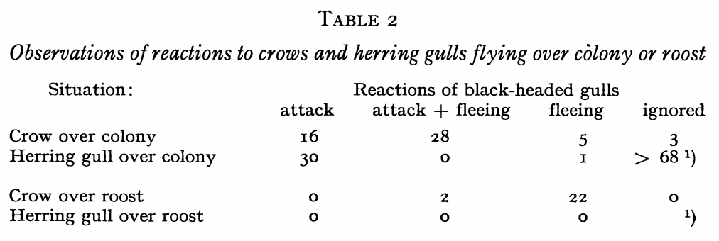
Observational
Prediction 1: Bird will only mob potential predators, not non-predators
3 Approaches: Mobbing behavior in the black-headed gull
Notes:
The Herring gull, for the most part, doesn’t predate on black-headed gull nests.
In turn, they aren’t mobbed; only the crows are.

Slide 29
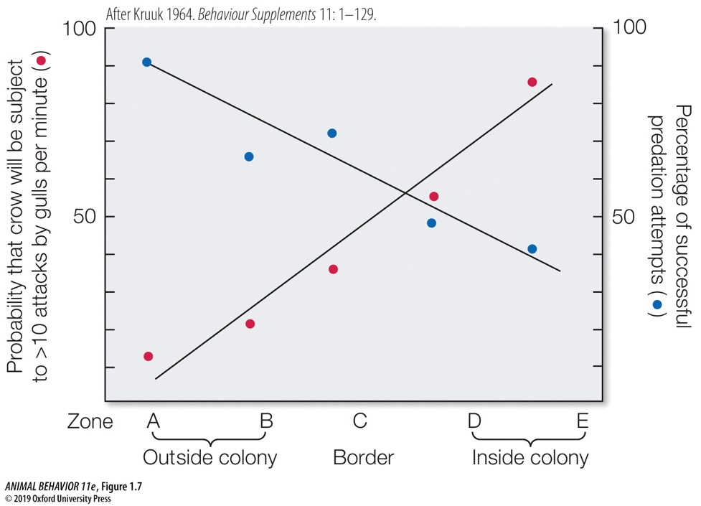
Experimental
Prediction 2: Predation will be higher when there is less mobbing
3 Approaches: Mobbing behavior in the black-headed gull
Notes:
The Herring gull, for the most part, doesn’t predate on black-headed gull nests.
In turn, they aren’t mobbed; only the crows are.

Slide 30
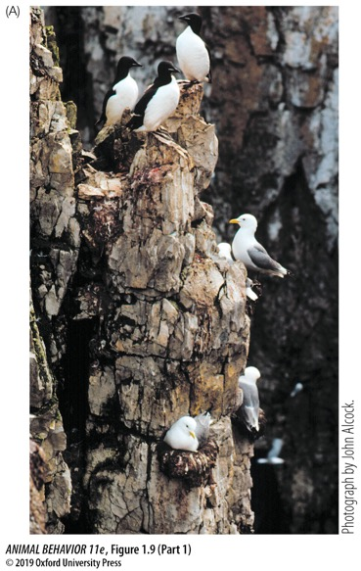
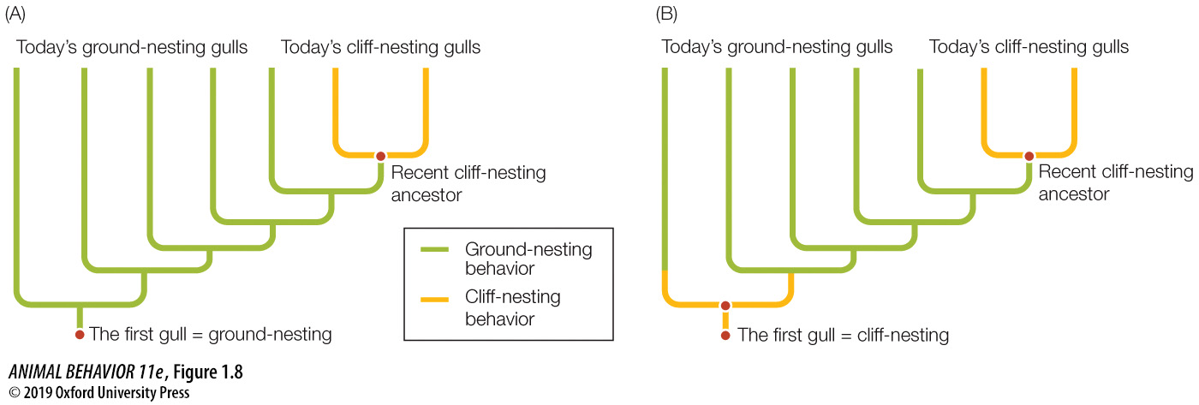
Comparative
3 Approaches: Mobbing behavior in the black-headed gull
Notes:
Kittiwakes are small birds closely related to black-headed gulls,
BUT they nest on steep cliffs. They also do not mob predators – they have few predators, and the cost-benefit ratio of mobbing is not in their favor

Slide 31
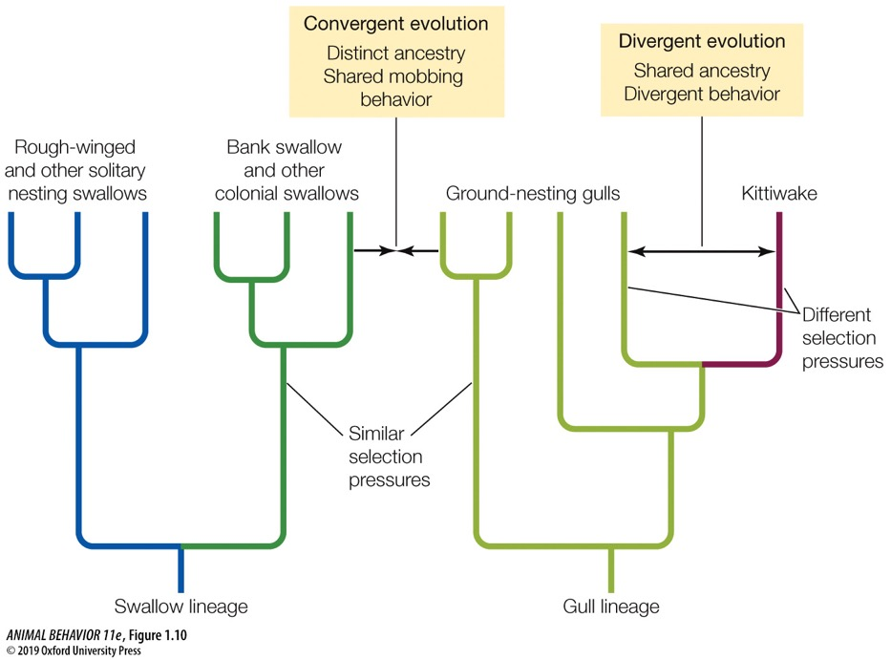
Comparative
3 Approaches: Mobbing behavior in the black-headed gull
Notes:
The comparative approach yields interesting findings looking at a broader phylogeny.
Divergent evolution between kittiwakes and ground-nesting gulls
Convergent evolution between ground-nesting gulls and colonial swallows.

Slide 32
Outline
Welcome!
What is behavior?
Why do we care?
Brief basics
Methods of animal behavior research
Planet Earth

Slide 33
Planet Earth: DIY study
Think of 1 question you have about some aspect of animal behavior.
Develop a hypothesis and prediction(s)
Hypothesis = explanation about how the world works

Slide 34
Planet Earth: DIY study
Discuss how you would re-frame that question/hypothesis in 4 ways, corresponding to Tinbergen’s 4 questions
 |  | Timing of Analysis
 |  | Contemporary | Chronicle
Level of Analysis | Proximate | Mechanism (causation) | Ontogeny (development)
 | Ultimate | Adaptive Value (function) | Phylogeny (evolution)

Slide 35
Planet Earth: DIY study
For 1 of those, design a study to test that question/hypothesis. It can be:
Observational
Experimental
Comparative

Slide 36
Planet Earth: Move aside, Sir David Attenborough
https://www.youtube.com/watch?v=sm11C8l9Xwk
Hypothesis: Younger males have better competitive advantage
How can you test that?

Slide 37
Planet Earth: Move aside, Sir David Attenborough
https://www.youtube.com/watch?v=1zxJPQlFFTI
What’s happening??
Develop a question or hypothesis
How can you study this? What would you do/record?
Notes:
What’s happening?
Males cooperate to mate.
What kinds of questions might be really interesting here?
Why are they cooperating?
Are they related?
Do they stick to the same group for a long time?
How do they choose who gets to mate?
How would you study this?
In wild: tagging, very careful observation, long-term studies
In captivity: a bit easier
From Lukianchuk & Doucet 2014: “In lek‐breeding systems where many males gather at display sites, males benefit from the establishment of dominance hierarchies to reduce intrasexual aggression and the associated risk of injuries. Long‐tailed manakins (Chiroxiphia linearis) exhibit an exploded lek‐breeding system wherein the two top‐ranking males at each display site team up to perform elaborate coordinated courtship displays for females. Young males undergo delayed plumage maturation whereby they acquire distinct pre‐definitive plumage patterns each year until they attain definitive plumage in their fifth year. This unique characteristic is thought to have evolved as a status‐signalling mechanism to aid in the establishment of an age‐graded dominance hierarchy in which older males are dominant to younger males. Previous research has shown evidence for such a dominance hierarchy among alpha and beta males; however, the presence of this hierarchy among males of other age classes has never been quantified. In this study, we investigated the presence of an age‐graded dominance hierarchy by determining whether older males direct more aggressive behaviours towards younger males. We also investigated whether status signalling is less clear within age classes than between age classes, by determining whether males within the same age class exhibit more aggression towards each other. We found that older males performed aggressive behaviours towards younger males much more frequently than younger males performed aggressive behaviours towards older males. We also found that some aggressive interactions occurred between males within the same age class more frequently than between males from different age classes. Our study provides some evidence for an age‐graded dominance hierarchy among male long‐tailed manakins of all age classes and also provides some support for the status‐signalling hypothesis. However, further research is needed to conclusively establish the presence of a linear dominance hierarchy among younger male manakins. This research may help us better understand the evolution of complex hierarchical systems in animals.”
From Brodt et al 2014: “Blue Manakin Chiroxiphia caudata (Pipridae) has a lek mating system in which males cooperate in teams of two or more individuals for courtship displays to females. Males ascend through a dominance hierarchy to assume the rank of alpha male. Only alpha males copulate with females. In this study, we describe the ascension of a male to the alpha rank following the disappearance of the previous alpha male. The study was conducted in the seasonal Atlantic Forest of Southern Brazil. We observed nine banded males at two adjacent leks. The gamma male at the more successful lek also acted as an alpha male at a less successful lek 314 m away. Upon the disappearance of the alpha male at the more successful lek, the gamma gave up his alpha rank at the less successful lek and ascended to the alpha rank at the more successful lek, bypassing the beta male. Although a previous study suggests a strictly linear dominance hierarchy in C. caudata, with beta male ascending to alpha status, our results suggest that the rising to become the alpha male may be a more flexible and dynamic process than previously reported.”
From Francisco et al 2009: “Patterns of relatedness among males attending leks can provide insights into how this reproductive behavior has evolved. Past research on birds has found that lekking males show either elevated levels of relatedness, supporting a mechanism based on kin selection, or a lack of relatedness, supporting a direct-benefits mechanism. We show that males attending Blue Manakin (Chiroxiphia caudata) leks exhibit a third pattern, with leks consisting of mixtures of related and unrelated individuals. Kinship analyses of males sampled from 13 leks in three local populations showed that close male relatives (r = 0.5) were present, but only at half the leks sampled. Analysis of male relatedness among leks in each local population showed that overall levels of relatedness were not significantly different between males from the same lek and those at different leks and that no isolation-by-distance relationships were present. We argue that these patterns are most parsimoniously explained as a byproduct of limited dispersal rather than as direct selection operating via reproductive behavior to produce specific patterns of relatedness among lek attendees.”

Slide 38
Planet Earth: Move aside, Sir David Attenborough
https://www.youtube.com/watch?v=LU8DDYz68kM
What’s happening??
How can you study this? What would you do/record?

Slide 39
Planet Earth: Move aside, Sir David Attenborough
https://www.youtube.com/watch?v=GBTML1zcqQA
What’s happening??
Develop a question or hypothesis
How can you study this? What would you do/record?
Notes:
Robin parasitized by a cowbird; cowbirds are generalist brood parasites

Slide 40
Planet Earth: Move aside, Sir David Attenborough
https://www.youtube.com/watch?v=PpkTJtvFDH0
What’s happening??
Develop a question or hypothesis
How can you study this? What would you do/record?
Notes:
See: Egg discrimination along a gradient of natural variation in eggshell coloration. Daniel Hanley, Tomáš Grim, Branislav Igic, Peter Samaš, Analía V. López, Matthew D. Shawkey, Mark E. Hauber. Published 8 February 2017. DOI: 10.1098/rspb.2016.2592

Slide 41
Planet Earth: Move aside, Sir David Attenborough
https://www.youtube.com/watch?v=4cO6TW9NP6A
What’s happening??
How can you study this? What would you do/record?

