Slide 1
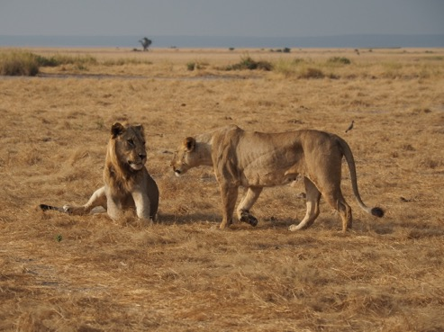
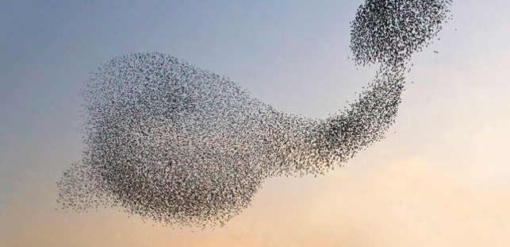
Foundations of Animal Behavior Week 1: What is behavior and how do we study it?
OLLI Course
17 January 2020
Emily Levy
Notes:
Swifts: J. Van der Greef

Slide 2
Outline
Welcome!
What is behavior?
Why do we care?
Brief basics
Methods of animal behavior research
Planet Earth

Slide 3
Outline
Welcome!
What is behavior?
Why do we care?
Brief basics
Methods of animal behavior research
Planet Earth

Slide 4
Welcome!
Name
A bit about you
Why you signed up for this class & what you’re excited to learn about

Slide 5
Welcome!

Slide 6
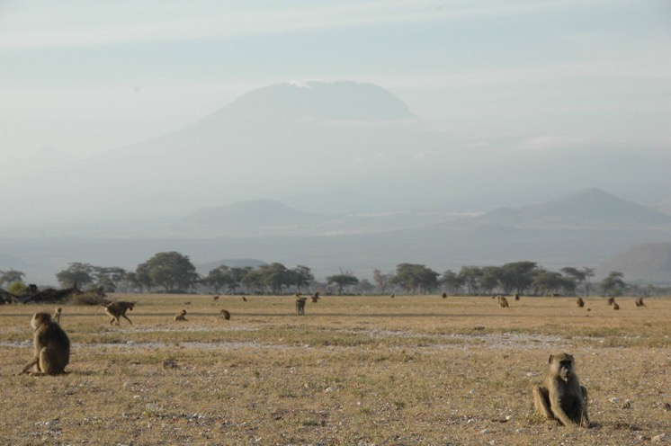
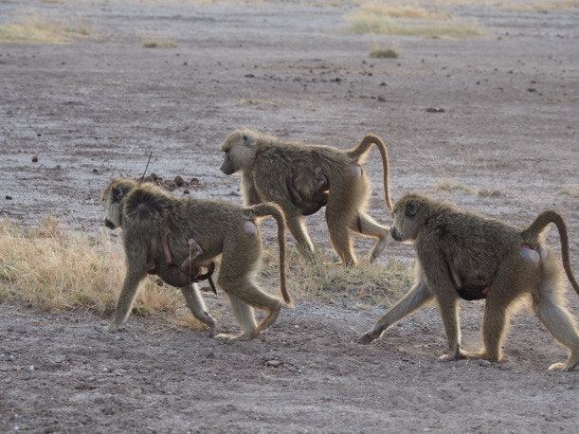
Welcome!

Slide 7
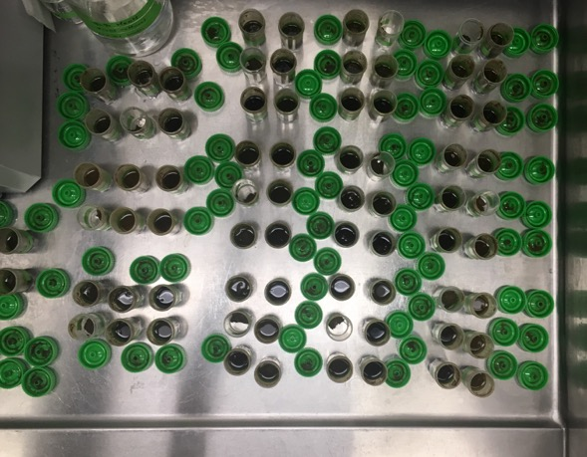
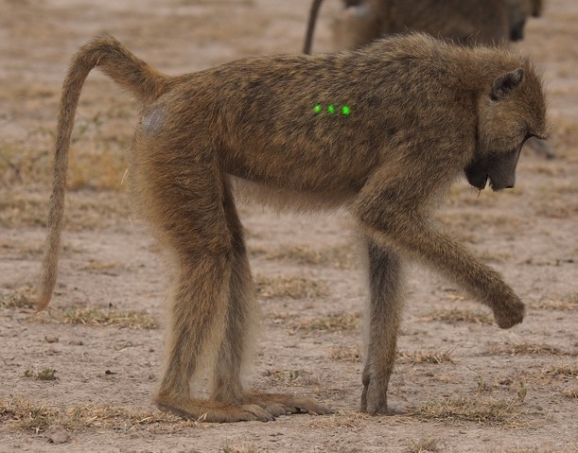
Welcome!

Slide 8
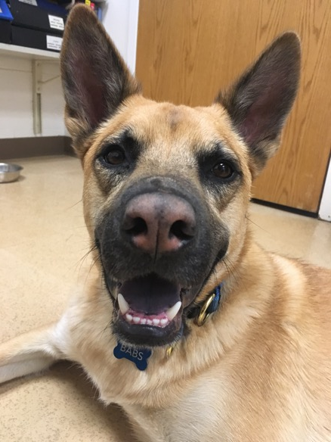
Welcome!

Slide 9
Outline
Welcome!
What is behavior?
Why do we care?
Brief basics
Methods of animal behavior research
Planet Earth
Notes:
How would you define behavior?

Slide 10
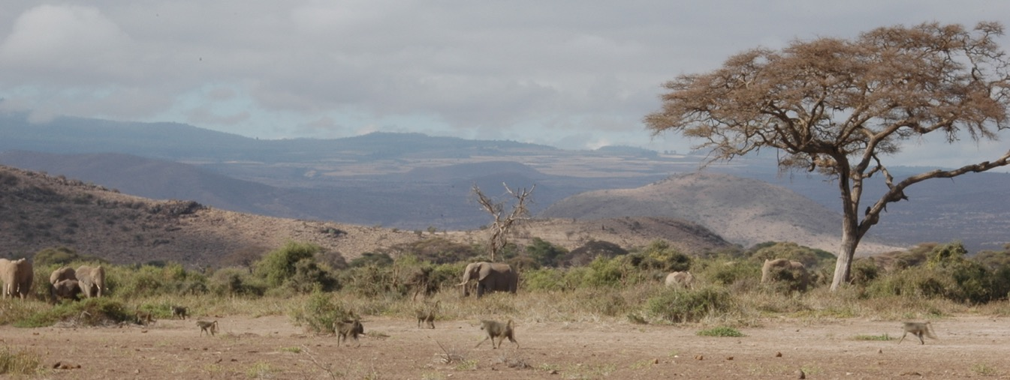
What is behavior?
An organism’s response(s) to a stimulus
Organism-level
Stimulus=environment
Response=‘decision’
‘Decisions’ don’t require cognitive or conscious processes
Notes:
Organism: Usually think about it on the organism level (ie, not an organ or cellular level)
Stimulus: Something in the environment
Response: Change in state

