Slide 1
Animal emotions and the lives of our pets
Week 9
Foundations of Animal Behavior
Student’s choice week!
Emily Levy

Slide 2
DISCLAIMER: I don’t know much about these topics and didn’t have a ton of time to learn about them… So this isn’t the most comprehensive lecture. And I’ll frequently quote others who know a lot more than I do.
Frans de Waal
Notes:
Photo by Catherine Martin

Slide 3
Outline
Animal emotions
What are emotions?
How do we study them?
What are they good for?
Evidence in the literature (behavior, physiology & neuroscience)
Skeptic’s take
Lives of our pets
Brief history of cat & dog domestication
Can we know what our pets think and feel?

Slide 4
Animal Emotions
What are emotions?
How do we study them?
What are they good for?
Evidence in the literature (behavior, physiology & neuroscience)
Skeptic’s take

Slide 5
Notes:
https://www.youtube.com/watch?v=INa-oOAexno&t=6s

Slide 6
“The ‘emotions’ are excellent examples of the fictional causes to which we commonly attribute behavior.”
BF Skinner, Science and Human Behavior 1953
Skinner was the pioneer of behaviorism
Behaviorism was founded on the notion that all behavior was learned via conditioning/training.
Thus, internal and unlearned responses and/or processes (eg, thinking) were unnecessary to the study of animal behavior.
This only gets you so far if you want to understand an organism!

Slide 7
What are emotions? (as summarized in de Waal 2011)
“an orchestrated response to a significant event across multiple systems at once: perceptual, cognitive, motivational, expressive, bodily, and experiential” (Barrett et al 2006)
“To behave functionally according to evolutionary standards, the mind’s many subprograms need to be orchestrated so that their joint product at any given time is functionally coordinated, rather than cacophonous and self-defeating. This coordination is accomplished by a set of superordinate programs – the emotions.” (Cosmides & Tooby 2000)
“A passion wants something” – Emotions facilitate goal-oriented actions (Frijda 2004)
“Organisms have been selected to enter a particular bodily and mental state under particular circumstances: those who did furthered their interest better than those who did not”
“An emotion is a temporary state brought about by biologically relevant external stimuli, whether aversive or attractive. The emotion is marked by specific changes in the organism’s body and mind—brain, hormones, muscles, viscera, heart, etcetera. Which emotion is triggered is often predictable by the situation in which the organism finds itself, and can further be inferred from behavioral changes and evolved communication signals. There exists no one-on-one relation between an emotion and ensuing behavior, however. Emotions combine with individual experience and cognitive assessment of the situation to prepare the organism for an optimal response.” (de Waal 2011)

Slide 8
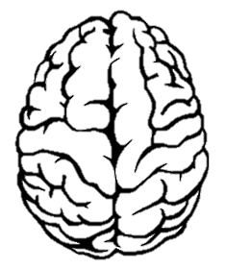
What they good for? (as summarized in de Waal 2011)
Stimulus
Instinctual response
Predetermined
Fixed
Emotional response
‘Not strictly predetermined’
Enable plastic behavior
Behavior

Slide 9
What they good for? Emily’s over-simplified take
Stimulus
Neural and physiological activity in response to stimulus feels like something.
That emotion can be simple (FEAR!) or complex (curious + cautious).
Our emotions help to coordinate an appropriate behavioral response.
Behavior

Slide 10
“It does nothing to promote our understanding of behavior to attribute it to an emotion if our only evidence of the emotion is the very behavior the emotion is supposed to explain”
D. McFarland, Oxford Companion to Animal Behaviour 1987

Slide 11
‘Although conscious feeling states are universally accepted as major distinguishing characteristics of human emotions, in animal research the issue of whether other organisms feel emotions is little more than a conceptual embarrassment’
Jaak Panksepp 2004

Slide 12
How do we study emotions in animals?
How do we study them in humans?
Self-report feelings
Physiology
Neuroscience
Animals can’t tell us how they feel
Lots of research tends to study animals as if they perceive the world from our perspective
But, some research can maybe help us peek into the emotions of animals

Slide 13
How do we study emotions in animals?
Take advantage of evolutionary context
‘Instead of assuming that animal emotions are necessarily simple and straightforward, it is more likely that if humans and related species respond similarly under similar circumstances, the emotions behind their responses are similar, too’ (de Waal 2011)
Measure associations between behavior and brain activity or physiology (in evolutionary context)
Notes:
‘If humans report high anxiety while showing amygdala activation and rats exhibit flight and freezing responses when their amygdala is electrically stimulated, it is hard to avoid the conclusion that we are dealing with one and the same state, that is, fear.” (de Waal 2011)

Slide 14
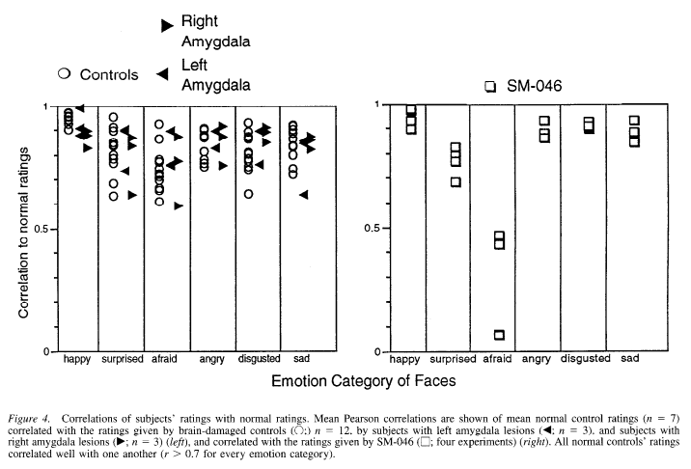
Evidence of animal emotions: Fear
Fear in humans…
Amygdala functions on at least one side
Neither left nor right amygdala functions
Adolphs et al 1995
Notes:
‘If humans report high anxiety while showing amygdala activation and rats exhibit flight and freezing responses when their amygdala is electrically stimulated, it is hard to avoid the conclusion that we are dealing with one and the same state, that is, fear.” (de Waal 2011)

Slide 15
Evidence of animal emotions: Fear
Fear in humans…
Amygdala functions on at least one side
Neither left nor right amygdala functions
In humans, the amygdala processes fear.
→ Does the amygdala process fear in other animals?
Adolphs et al 1995
Notes:
‘If humans report high anxiety while showing amygdala activation and rats exhibit flight and freezing responses when their amygdala is electrically stimulated, it is hard to avoid the conclusion that we are dealing with one and the same state, that is, fear.” (de Waal 2011)

Slide 16
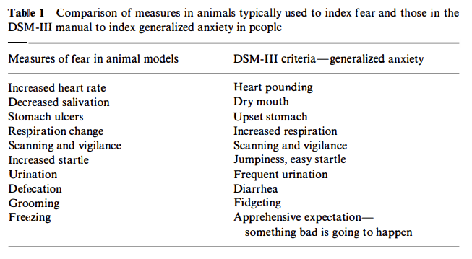
Evidence of animal emotions: Fear
Fear in humans…looks like fear in rodents
Davis 1992
Notes:
‘If humans report high anxiety while showing amygdala activation and rats exhibit flight and freezing responses when their amygdala is electrically stimulated, it is hard to avoid the conclusion that we are dealing with one and the same state, that is, fear.” (de Waal 2011)

Slide 17
Evidence of animal emotions: Fear
Fear in humans…looks like fear in rodents
Animals show similar behavioral responses to
things that should make them scared
Davis 1992
Notes:
‘If humans report high anxiety while showing amygdala activation and rats exhibit flight and freezing responses when their amygdala is electrically stimulated, it is hard to avoid the conclusion that we are dealing with one and the same state, that is, fear.” (de Waal 2011)

Slide 18
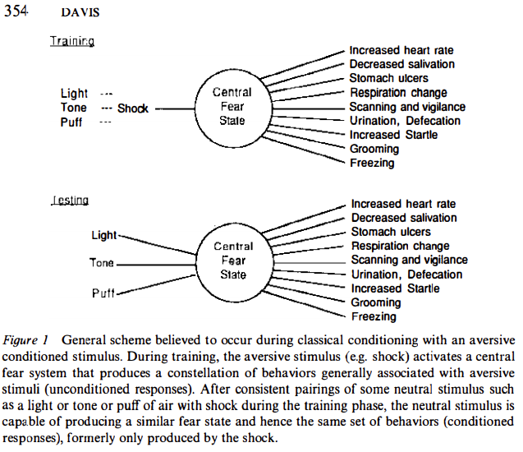
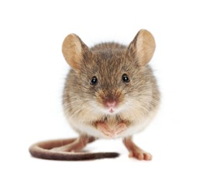
Evidence of animal emotions: Fear
Fear in humans…looks like fear in rodents
Davis 1992
Notes:
‘If humans report high anxiety while showing amygdala activation and rats exhibit flight and freezing responses when their amygdala is electrically stimulated, it is hard to avoid the conclusion that we are dealing with one and the same state, that is, fear.” (de Waal 2011)

Slide 19
Evidence of animal emotions: Fear
Fear in humans…looks like fear in rodents
You can train animals to be fearful of stimuli really easily
AND, stimulating the amygdala directly elicits these same responses
Davis 1992
Notes:
‘If humans report high anxiety while showing amygdala activation and rats exhibit flight and freezing responses when their amygdala is electrically stimulated, it is hard to avoid the conclusion that we are dealing with one and the same state, that is, fear.” (de Waal 2011)

Slide 20
Evidence of animal emotions: Contagion
Emotional contagion: “adopting the same emotion” as another individual (de Waal 2011)
Precursor to empathy? Empathy requires an observer to access the internal state and situation of another (de Waal 2011, Preston & de Waal 2002)
You’re scared so I’m scared
You’re scared so I’m going to console you

Slide 21
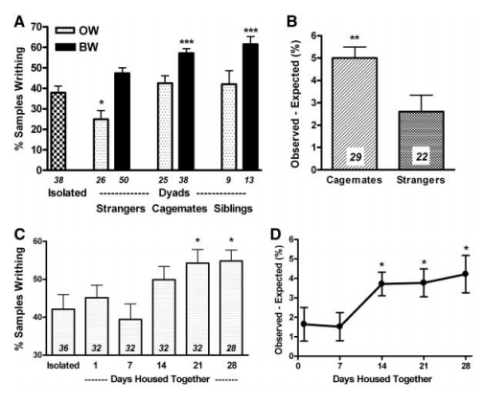
Evidence of animal emotions: Contagion
Mice who observed another mouse experience pain were pre-disposed to experience more pain
But only when they knew the other mouse
Langford et al 2006

Slide 22
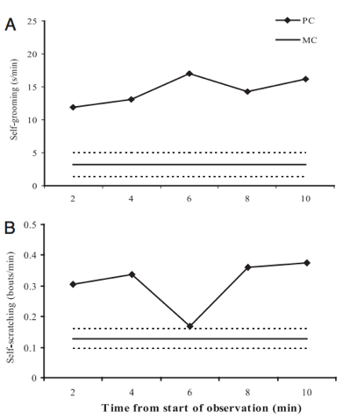
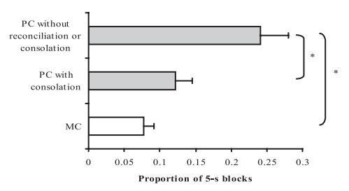
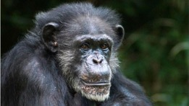
Evidence of animal emotions: Consolation
Without reconciliation (compare PC to MC)
PC = post-conflict; MC = control (no conflict)
Prediction: “consolation reduces post-conflict stress”
Measures of ‘stress’: self-scratching and self-grooming
Test for decrease in self-scratching and self-grooming after consolation
Consolation reduces self-scratching and grooming down to control levels
Proportion of time spent on self-directed behaviors
Fraser et al 2008

Slide 23
Skeptic’s take (and Emily’s responses)
We want animals to have emotions because…it’s cool! Ie, We are projecting
One response: It’s easy to project, but research also suggests conserved neurological and physiological responses to stimuli across species, including humans, suggesting similar experiences of those stimuli across species
The behaviors are the same whether we suggest animals experience emotion or not; it is more parsimonious to leave the emotions out
One response: Emotions as defined here serve to organize the neural response to stimuli in order to produce an adaptive behavior. So they have a function that we can study instead of making it a black box
Sure, all mammals experience fear, but saying that a chimp responds similarly to a human and thus experiences more complex emotions – like love or grief – is a leap
One response: For now the empirical evidence relies mostly on comparing behavioral responses between humans and other animals, so it is somewhat of a leap. Perhaps advances in neuroscience will help us establish parallels in brain activity as well
Sure, you might see parallels in brain activity between humans and other species, but that doesn’t mean other animals are feeling things the same way we do
One response: Why wouldn’t it? But true, we have no way of knowing – but I also have no way of knowing how you feel unless you tell me, and self-report is notoriously inaccurate.

Slide 24
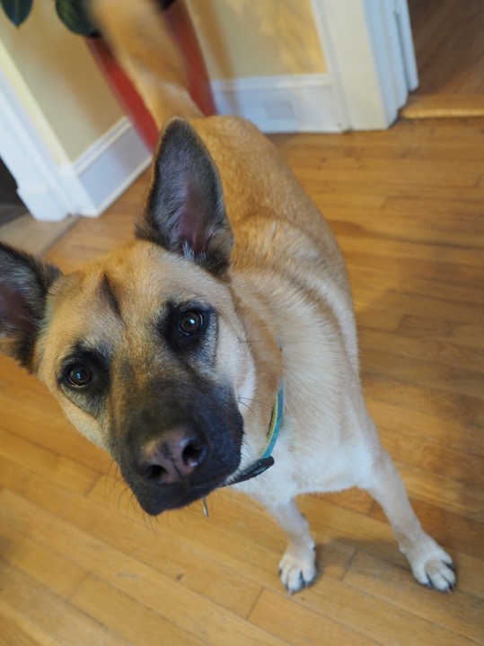
Lives of our pets
Brief history of cat & dog domestication
Can we know what our pets think and feel?

Slide 25
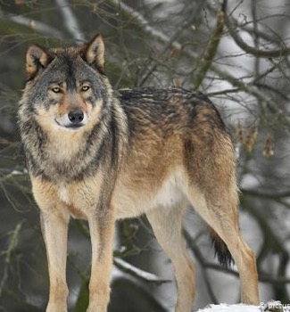
Brief history of domestication: Dogs
The domestication of dogs was one of the most extraordinary events in human history
Brian Hare
First dogs domesticated 14,000-40,000 years ago
Especially friendly wolves sidled up to humans.
In one respect, dogs domesticated themselves – only friendliest ones hung around with humans, and they reaped the benefits
Then artificial selection for various tasks → many breeds!
Differences in the DNA sequence in one gene can explain some of the social differences between dogs and wolves
This gene is also mutated in humans with Williams-Beuren syndrome

Slide 26
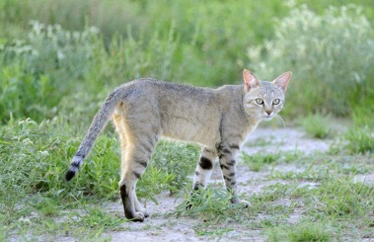
Brief history of domestication: cats
African wildcat → Domestic housecat
2 waves, both driven by large shifts in human lifelihoods from hunter-gatherer to agriculture
~9000 years ago in near east: farmers stored grains, which attracted wildcats.
Spread a bit through Europe
~3000 years ago in ancient Egypt
These guys were more successful than wave 1 (ended up all over Europe)
Breeding docile cats to keep in households
Both cats and dogs have been extremely successful – about 600 million cats in the world, and 900 million dogs!!!

Slide 27
Can we know what our pets think and feel?
Sort of!
Methods:
Measure behavior, hormones, neural activity

Slide 28
Let’s figure it out together! Discussion about readings
Are the researchers or journalists anthropomorphizing?
If so, is it ok to anthropomorphize in this context?
Can you think of alternative hypotheses that might explain the findings presented?
Did the researchers actually study what they set out to study? Do their data directly address their hypotheses and predictions?
What more do you want to know?

Slide 29
Final thoughts
Feedback please!
Scott’s recommended Coursera classes
Chimpanzee Behavior and Conservation
Dog Emotion and Cognition (Brian Hare)
The Truth About Cats and Dogs
THANK YOU!
Notes:
You hopefully can watch animal behavior and think about ecology, evolution, and mechanisms!

