Slide 1
Geometry for the Selfish Herd WD Hamilton, 1971
a short interactive simulation by Emily Levy
BBC
Notes:
Datasheet (you’ll need to make your own copy – make sure the conditional formatting copies too!)
https://docs.google.com/spreadsheets/d/1pZ3OcBtpMoeeR0m3NPbQpK2kL1-Mdulm4tubLsTkYBY/edit?usp=sharing

Slide 2
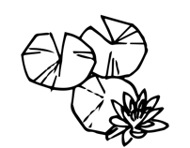
Snake: Alice Noir
Frog: Olivia Habermel
Lily pad: Linseed studio
Noun Project
Notes:
Imagine a circular lily pond.

Slide 3
Snake: Alice Noir
Frog: Olivia Habermel
Lily pad: Linseed studio
Noun Project
Notes:
Imagine that the pond shelters a colony of frogs and a water-snake.
The snake preys on the frogs but only does so at a certain time of day -

Slide 4
zzZzZzZZ
Snake: Alice Noir
Frog: Olivia Habermel
Lily pad: Linseed studio
Noun Project
Notes:
up to this time it sleeps on the bottom of the pond.

Slide 5
I’m hungry!
Snake: Alice Noir
Frog: Olivia Habermel
Lily pad: Linseed studio
Noun Project
Notes:
Shortly before the snake is due to wake up all the frogs climb out onto the rim of the pond.
This is because the snake prefers to catch frogs in the water.

Slide 6
Snake: Alice Noir
Frog: Olivia Habermel
Lily pad: Linseed studio
Noun Project
Notes:
If it can’t find any, however, it rears its head out of the water and surveys the disconsolate line sitting on the rim…and snatches the nearest one.

Slide 7
Snake: Alice Noir
Frog: Olivia Habermel
Lily pad: Linseed studio
Noun Project
Notes:
If it can’t find any, however, it rears its head out of the water and surveys the disconsolate line sitting on the rim…and snatches the nearest one.

Slide 8
Snake: Alice Noir
Frog: Olivia Habermel
Lily pad: Linseed studio
Noun Project
Notes:
If it can’t find any, however, it rears its head out of the water and surveys the disconsolate line sitting on the rim…and snatches the nearest one.

Slide 9
Snake: Alice Noir
Frog: Olivia Habermel
Lily pad: Linseed studio
Noun Project
Notes:
If it can’t find any, however, it rears its head out of the water and surveys the disconsolate line sitting on the rim…and snatches the nearest one.

Slide 10
Knowing that the snake is about the appear, will the frogs be content with their initial positions?
Snake: Alice Noir
Frog: Olivia Habermel
Lily pad: Linseed studio
Noun Project
Notes:
Now suppose that the frogs are given opportunity to move about on the rim before the snake appears, and suppose that initially they are dispersed in some rather random way.
Knowing that the snake is about to appear, will all the frogs be content with their initial positions?

Slide 11
You are the
Avoid the
H
A
G
B
F
C
E
D
Snake: Alice Noir
Frog: Olivia Habermel
Noun Project
Notes:
Your turn!
When I reach 1, everyone annotate the slide (with Zoom) with a shape (star, heart, etc) along the edge of the pond.
Record results in the datasheet

Slide 12
You are the
Avoid the
H
A
G
B
F
C
E
D
Snake: Alice Noir
Frog: Olivia Habermel
Noun Project
Notes:
If the snake appears here, who gets eaten?
Make sure they understand the ‘domain of danger’!!!

Slide 13
You are the
Avoid the
H
A
G
B
F
C
E
D
Snake: Alice Noir
Frog: Olivia Habermel
Noun Project
Notes:
What about here?
Make sure they understand the ‘domain of danger’!!!

Slide 14
You are the
Avoid the
H
A
G
B
F
C
E
D
Snake: Alice Noir
Frog: Olivia Habermel
Noun Project
Notes:
What about here?
Make sure they understand the ‘domain of danger’!!!

Slide 15
You are the
Avoid the
H
A
G
B
F
C
E
D
Snake: Alice Noir
Frog: Olivia Habermel
Noun Project
Notes:
What about here?
[Make sure students understand that the ‘domain of danger’ is in-between the mid-way to their left neighbor and the mid-way to their right neighbor.]

Slide 16
You are the
Avoid the
H
A
G
B
F
C
E
D
Snake: Alice Noir
Frog: Olivia Habermel
Noun Project
Notes:
Do you want to move? [Yes!]
I’m going to count down from 5.
By 3, you should be hovering your cursor over where you want to move so you’re ready to annotate the slide (using Zoom) - but DON’T DO IT YET.
On 2, I’m going to clear prior annotations so we don’t get confused by the old placements.
And on 1, place your new marker down.
Record the results
___
Repeat several times – should start clumping pretty quickly! If not, make sure they understand the general strategy (minimize domain of danger)

Slide 17
What was this all about?

Slide 18
Hamilton’s Selfish Herd
…each will have a better chance of not being nearest to the snake if he is situated in a narrow gap between two others
domain of danger
…usually neighbours will be moving as well and one can imagine a confused toing-and-froing…
Hamilton 1971, Journal of Theoretical Biology

Slide 19
Hamilton’s Selfish Herd
What will be the result of this communal exercise? Devious and unfair as usual, natural justice does not, in general, equalize the risks of these selfish frogs by spacing them out. On the contrary, with any reasonable assumptions about the exact jumping behaviour, they quickly collect in heaps.
The model gives the hint which I wish to develop: that even when one starts with an edgeless group of animals, randomly or evenly spaced, the selfish avoidance of a predator can lead to aggregation.
Hamilton 1971, Journal of Theoretical Biology

Slide 20
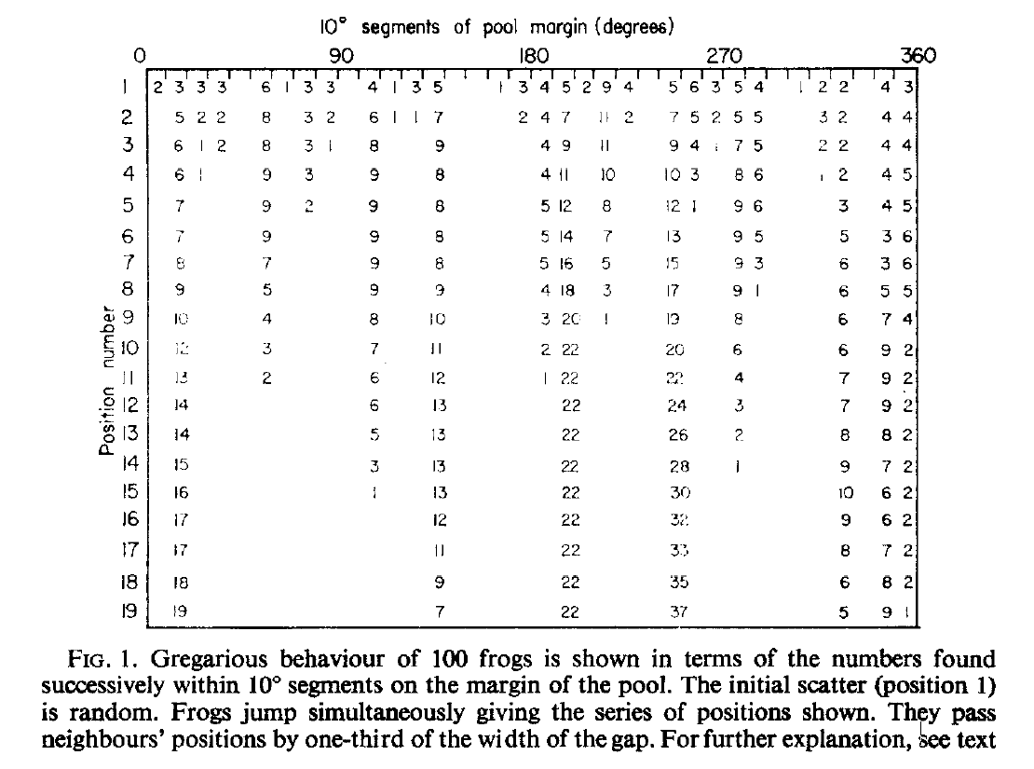
Hamilton’s Selfish Herd
Hamilton 1971, Journal of Theoretical Biology
Notes:
Did our demo recapitulate Hamilton’s simulation?
If extra time: How realistic is this whole theoretical set-up? How could you test it? To the extent that we buy it, what does it tell us about the evolution of social behavior, and about how we should go about identifying the functional significance of group-living?

